Slide 1


Molecular Interactions and Network Analysis From raw data to network analysis: PSICQUIC and Cytoscape
Pablo Porras Millán, IntAct

Slide 2
Session outline
Protein interactions and PPI databases introduction
Network representation and analysis: strategies and limitations.
The problem of data integration and PSICQUIC
Introduction to Cytoscape
Cytoscape hands-on session:
Importing and representing PPI data.
Representing external information in a network.
Topological analysis: cluster search with MCODE.
GO enrichment analysis using the ClueGO app.

Slide 3
Protein-protein interactions (PPIs) and PPI databases

Slide 4
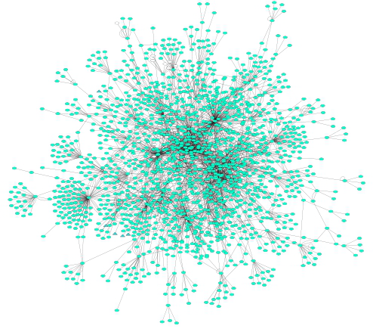
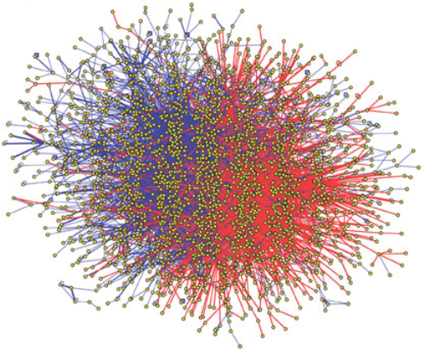
A couple of definitions…
Protein-protein interactions (PPIs): physical and selective contacts that happen between pairs of proteins, in certain molecular regions and in a defined biological context.
Interactome: the totality of PPIs that happen in a cell / in an organism / in a specific biological context...
Protein-protein interaction network: Graphical representation of a group of PPIs in which proteins are represented as nodes and interactions as edges.

Slide 5
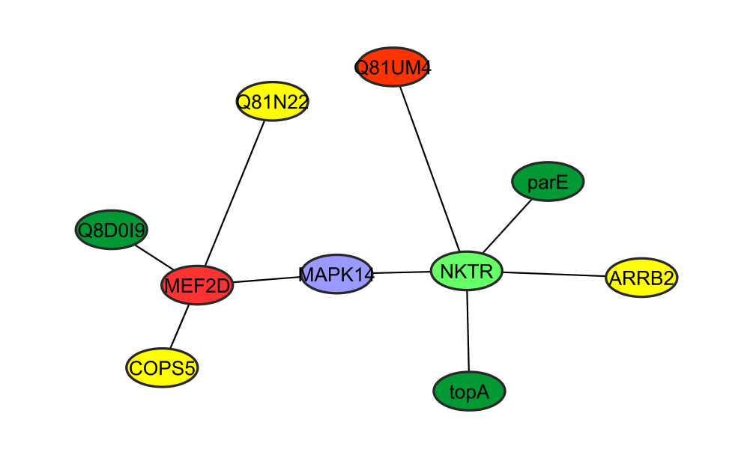
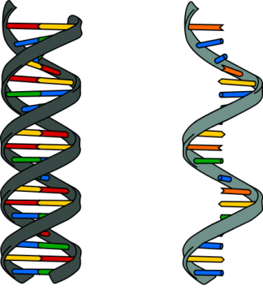
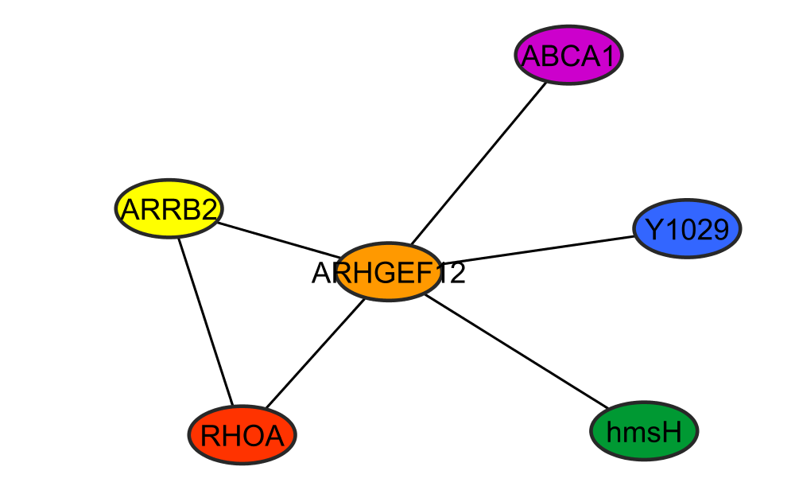
Why protein-protein interactions?
Gene level
Protein level
DNA
RNA
1 protein
=
n functions
=
n networks!
1 protein
=
1 function
WRONG!
To predict a protein biological function
“guilt by association”
proteins with similar functions should cluster together
To improve characterization of protein complexes and pathways
interaction networks work as a draft map that brings detail to biological processes and pathways

Slide 6
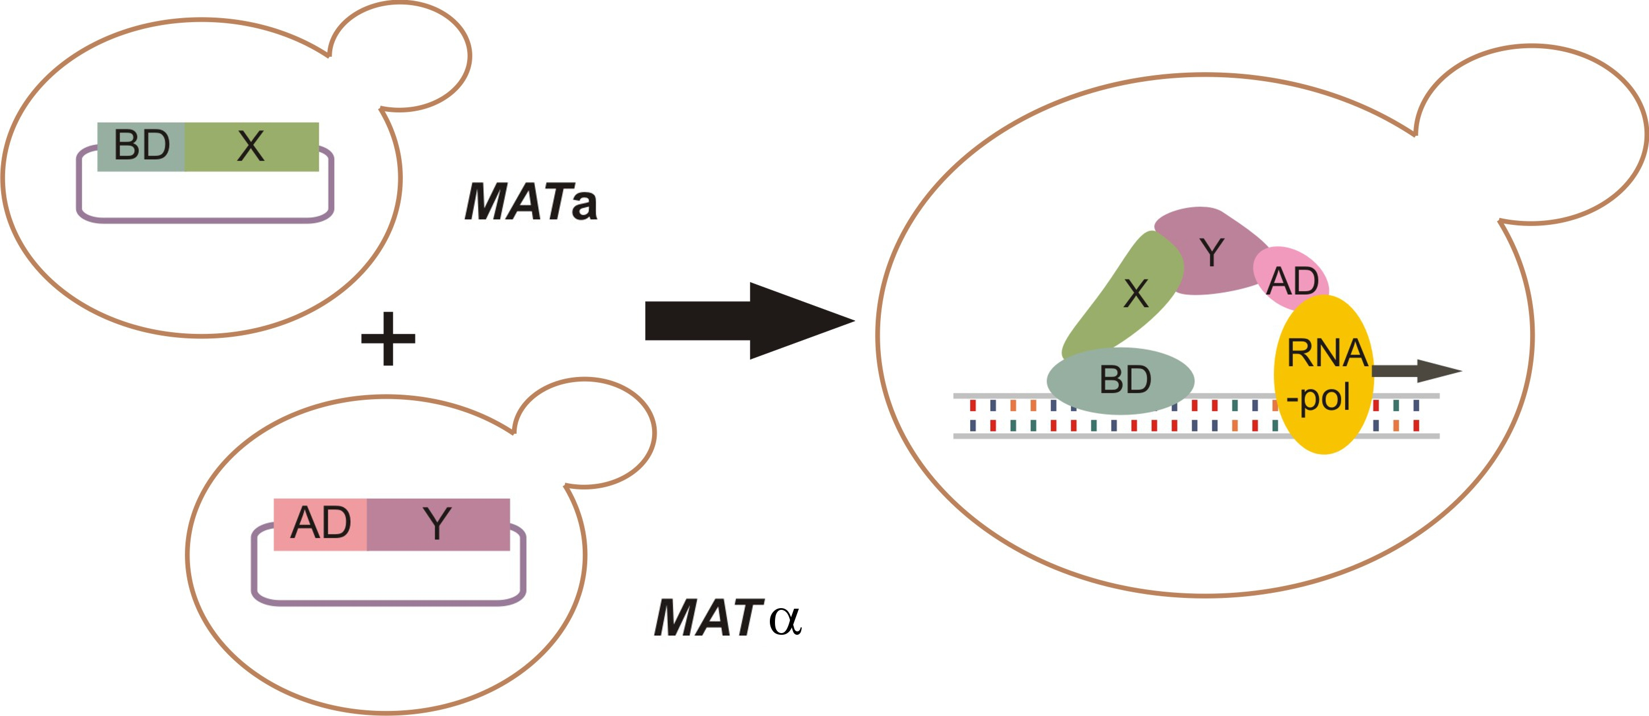
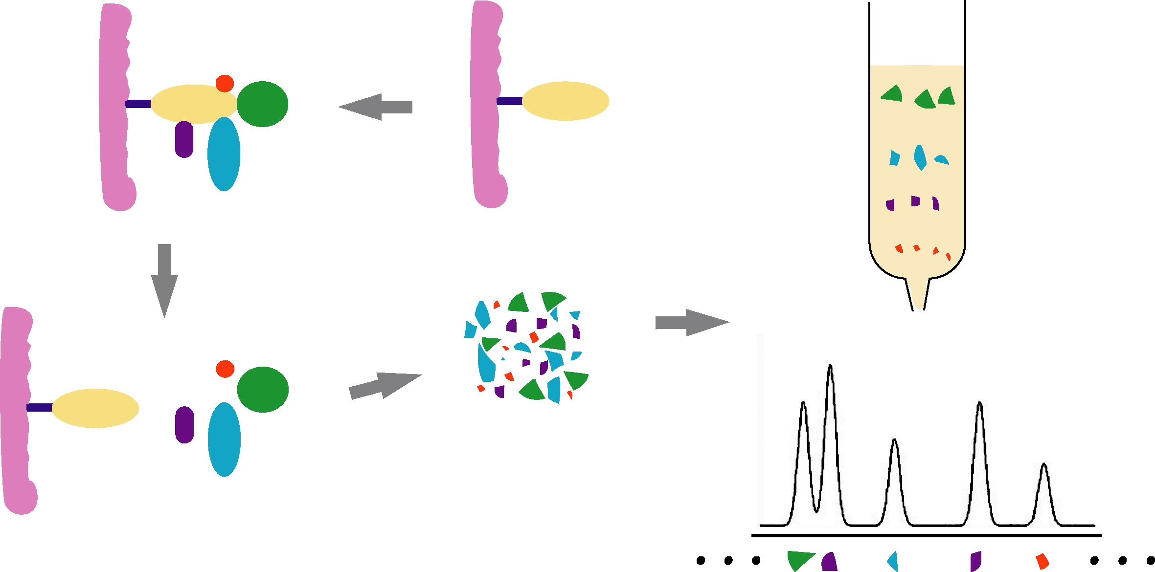
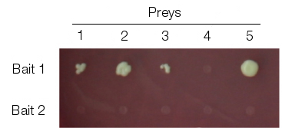
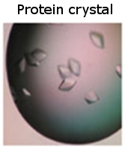
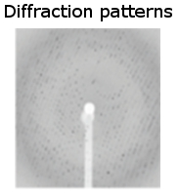
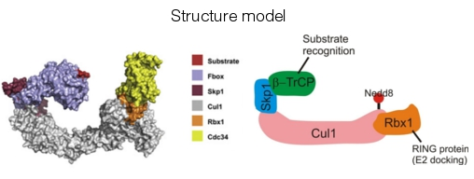
Protein-protein interaction detection methods
Yeast-two hybrid (Y2H)
Tandem affinity purification+ mass spectrometry (TAP-MS)
No single method can accurately reproduce a true binary interaction observed under physiological conditions – every interaction detected experimentally is fundamentally artefactual.
High-throughput
X-ray diffraction studies
Low-throughput
Notes:
There are multiple types of experimental methods used to detect protein-protein interactions. Two methods are important due to their use in high-throughput studies: these are the yeast two hybrid complementation assay (Y2H) and tandem-affinity purification followed by mass spectrometry (TAP-MS). Y2H is a fast, inexpensive and scalable method to detect binary interactions. TAP-MS will detect of multi-protein (n-ary) interactions. Other approaches that are less amenable to high-throughput setups are used in small-scale studies and provide more detailed structural and chemical information about the interaction.
Credits for structure model:
Cullin-complex model from Kleiger et al., Cell 139, 957-968, 2009.

Slide 7
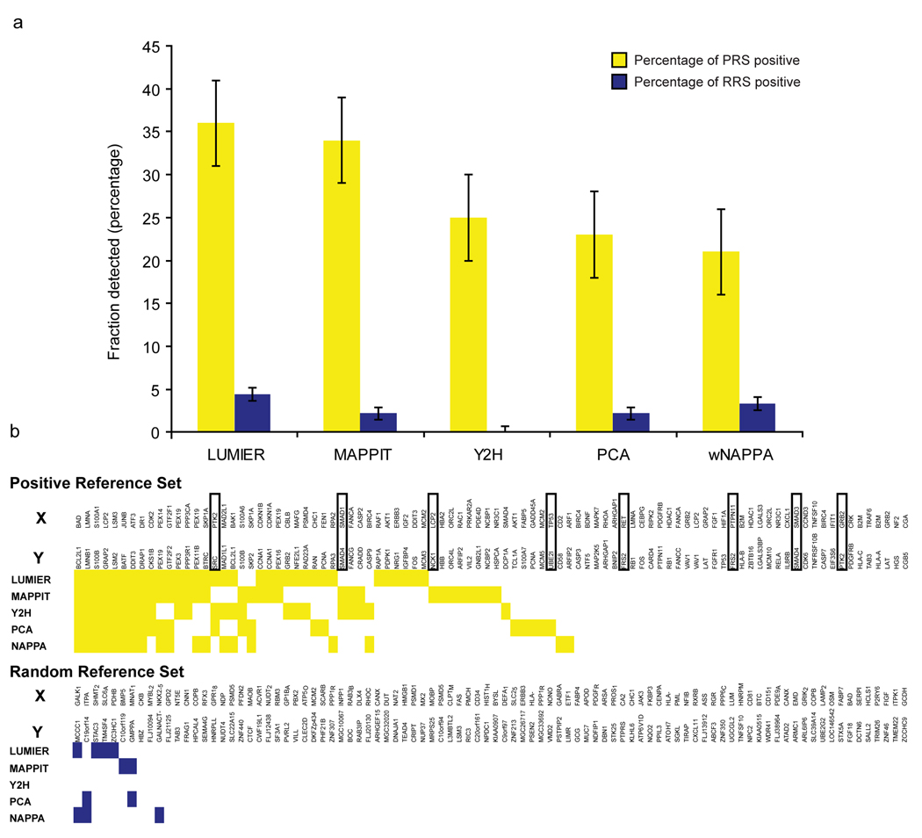
Protein-protein interaction detection methods
Braun et al., Nat Methods, 2008, PMID: 19060903.

Slide 8
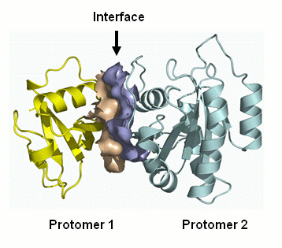
Representing PPIs: interaction domains
interaction domains
Overlap in sequence ranges:
Notes:
We can specifically describe interacting domains down to the residue level.
The domain can be represented as the specific range of the underlying amino acid sequence.
Including required PTM
These ranges are remapped whenever UniProtKB updates their protein sequences.

Slide 9
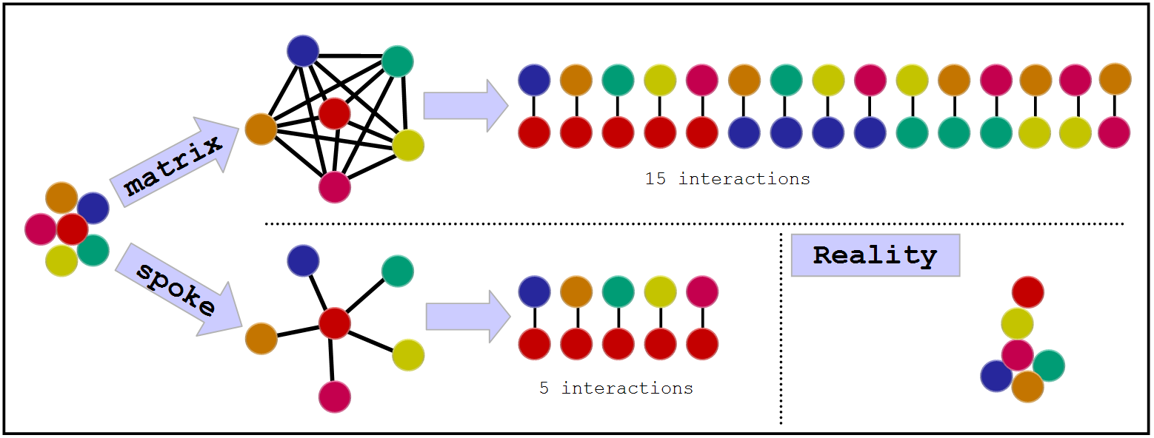
Representing PPIs:
The problem with complexes
Some experimental methods generate complex data: E. g. Tandem affinity purification (TAP)
There are two algorithms to transform this information into binary data:
Notes:
Computational tool to aid searches,
Transforms n-ary interaction into binary,
Both are somewhat wrong, spoke is said to generated 3 times less false positive (Bader et al.).

Slide 10








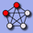




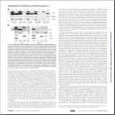
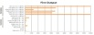

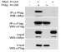
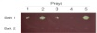

Interactions databases: types
Primary databases
Meta-databases
Predictive databases
De Las Rivas & Fontanillo, PLoS Computational biology, PMID: 20589078.

Slide 11




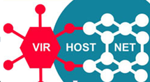
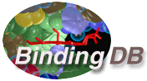

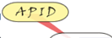


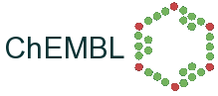


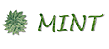

Databases: curation levels
SHALLOW
CURATION
DEEP CURATION

Slide 12
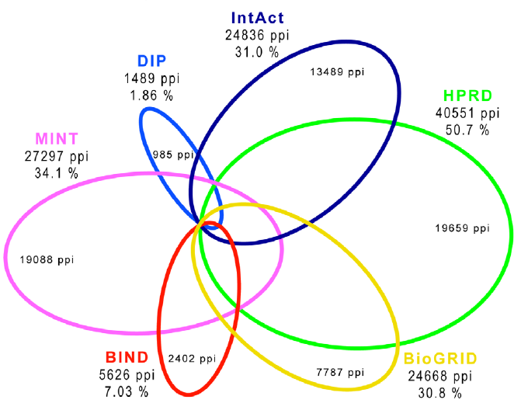
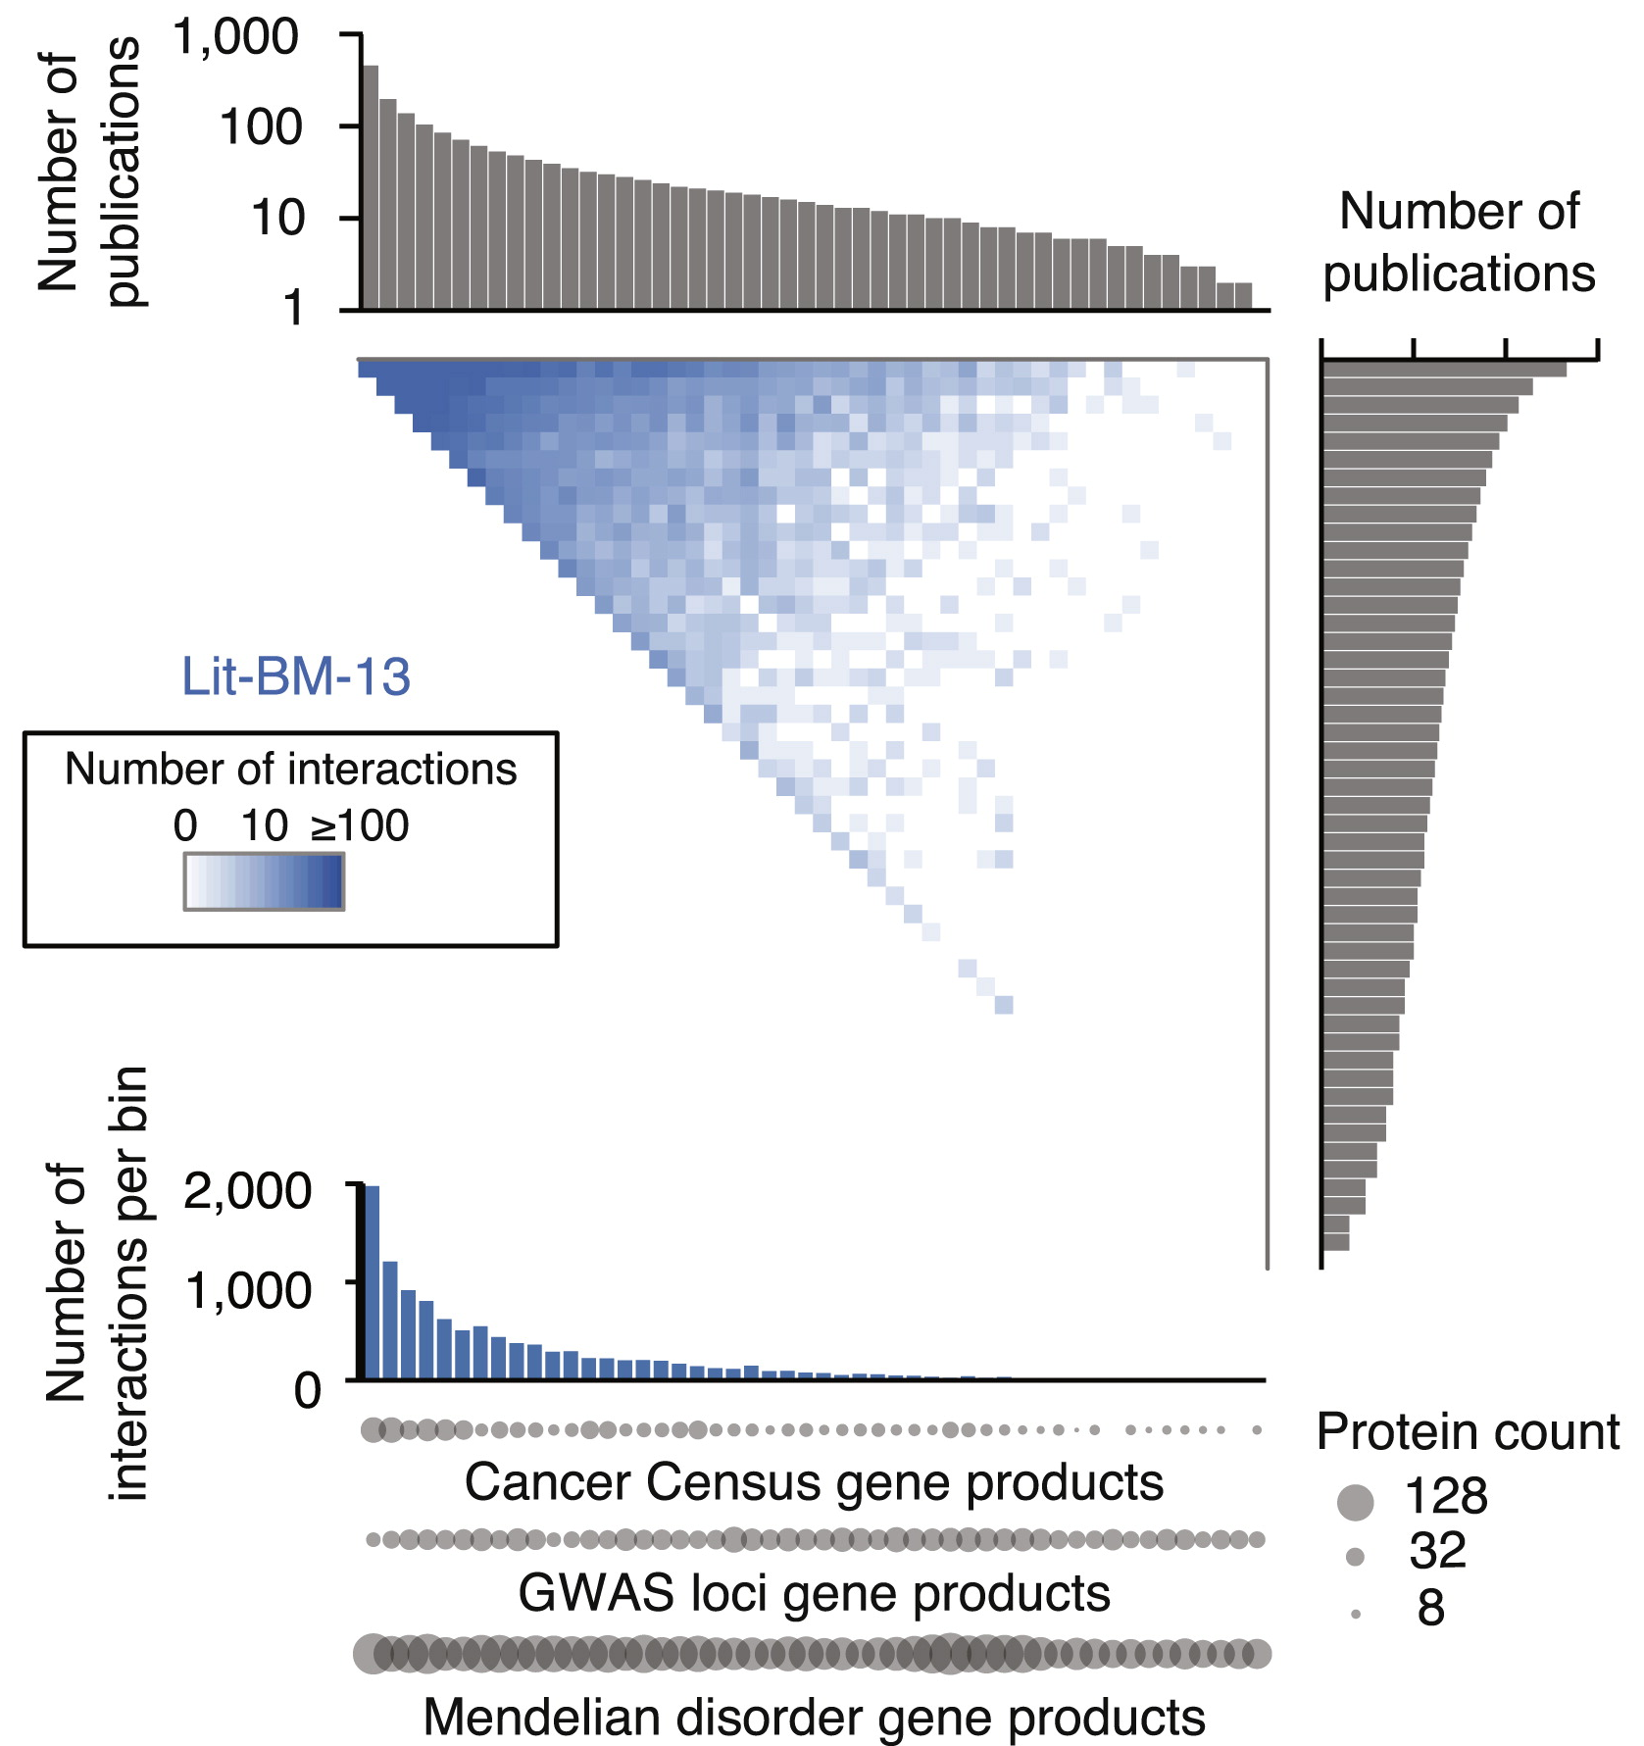
Primary databases: coverage and biases
Human PPIs coverage in the main
public primary databases
(Dec 2009)
Popularity bias in publicly available databases
(2013)
Roland et al., Cell, PMID: 25416956.
De Las Rivas & Fontanillo, PLoS Computational biology, PMID: 20589078.

Slide 13
Network representation and analysis: strategies and limitations

Slide 14
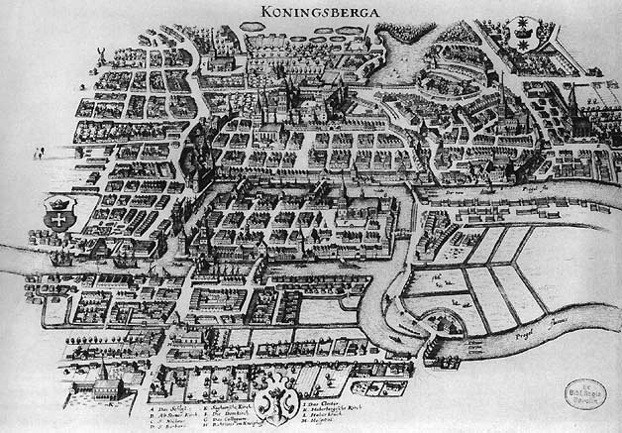

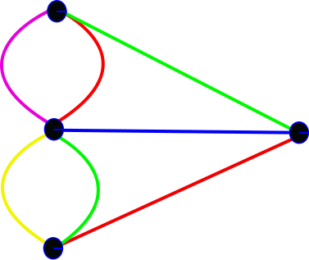
Network analysis: background
Biological network analysis: originated using tools and concepts from network and graph theory and social network analysis.
Graph theory: set of abstract concepts and methods that can be used to visualize and analyse biological networks.
First formulation of graph theory: The problem of the seven bridges of Koenigsberg (Kaliningrad).
“Solved” by Leonard Euler in 1735.
Set the basis of graph theory and the idea of topology.
Images taken under Creative Commons Attribution-Share Alike 3.0 Unported license from:
http://commons.wikimedia.org/wiki/File:Konigsberg_bridges.png
http://commons.wikimedia.org/wiki/File:K%C3%B6nigsberger_br%C3%BCcken.svg

Slide 15
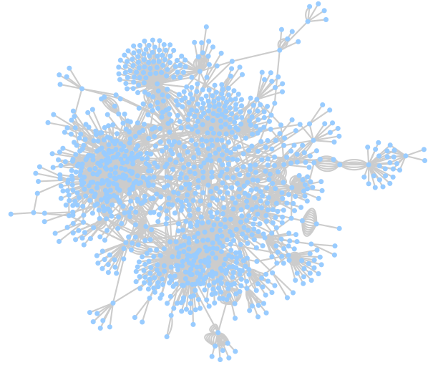
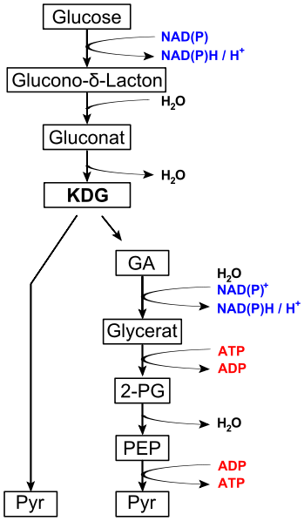
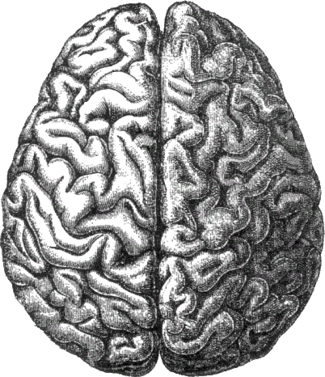
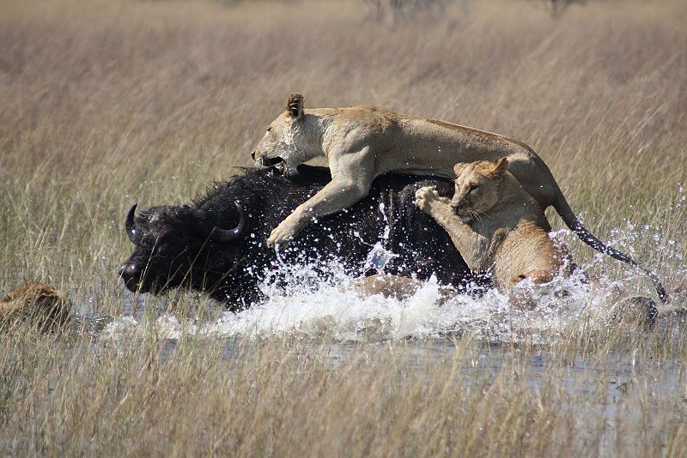
Network analysis in biology
Complex biological systems can be represented and analysed as networks, using the tools that graph theory gives us:
Ecological networks (food webs, species interaction networks…)
Neurological networks
Metabolic networks
Signalling networks
Genetic interaction networks
Gene regulatory networks
Protein-protein interaction networks
…
Images taken under Creative Commons Attribution-Share Alike 3.0 Unported license from:
http://commons.wikimedia.org/wiki/File:Lions_hunting_Africa.jpg
http://commons.wikimedia.org/wiki/File:Entner%E2%80%93Doudoroff_pathway_non-phosphorylative.svg
http://commons.wikimedia.org/wiki/File:Gene_Regulatory_Network_for_Initiation_of_Sporulation_in_Bacillus_subtilis.png

Slide 16
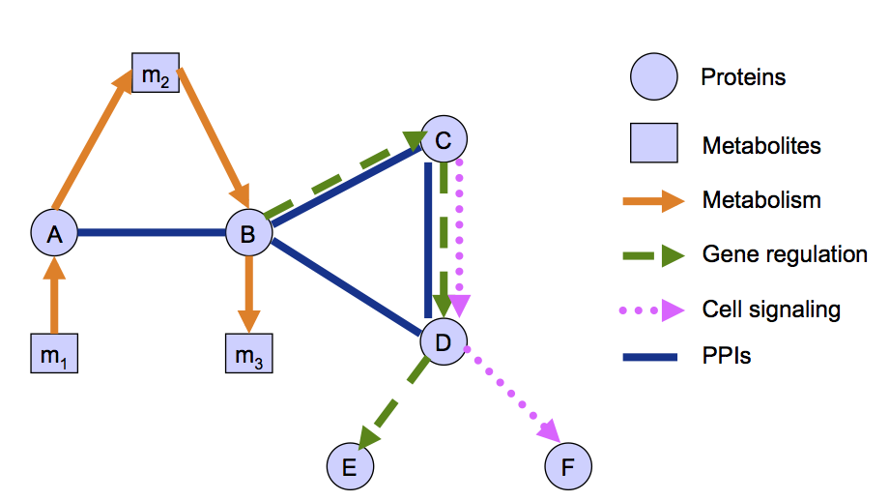
Networks of cell biology: a summary
Based on slides by Dr. Nataša Pržulj, Imperial College, London
Notes:
Different types of information can be represented in the shape of networks in order to model the cell. Some of the most used ones are:
1.- Metabolic networks:
a. They are used to study the biochemical reactions that allow an organism to grow, reproduce, respond to the environments and maintain its structure.
b. They are formed by metabolites and enzymes taking the role of nodes and the reactions describing their transformations being represented as directed edges.
c. They have been thoroughly characterized and well studied for quite some time now and built upon a solid base of knowledge.
2. Genetic interaction networks:
a. “Genetic interaction is the phenomenon where the effects of one gene are modified by one or several other genes.” (from http://www.nature.com/subjects/genetic-interaction).
b. These networks represent a functional relationship between different genes, rather than a physical one.
c. The genes are represented as nodes and their relationships as edges. Depending on the type of evidence behind the interaction, directionality can be inferred for the edges.
d. They can be built upon large- or small-scale experimental datasets.
3. Gene / transcriptional regulation networks:
a. They aim to represent how gene expression is controlled.
b. Genes and transcription factors are represented as nodes, while their relationship is depicted by different types of directional edges.
c. Usually generated via databases representing consensus knowledge (knowledgebases such as Reactome or KEGG), although some large-scale experimental datasets are also available.
d. Regulatory RNAs and other mechanisms are coming to form an integral part of this type of networks.
4. Cell signaling networks:
a. Cell signaling is the communication system that controls cellular activities.
b. Conceptually, this can be represented in the form of signaling pathways, ordered sequences of events that model the information flow within the cell.
c. Elements in the pathway (proteins, nucleic acids, metabolites) are represented as nodes and the directed edges linking them represents the flow of information.
d. Systematically represented in pathway databases such as Reactome, KEGG or Wikipathways. These aim to provide with a formal representation of current scientific consensus on how cell signaling works.
5. Protein-protein interaction networks:
a. They will be the subject of this course and they represent the physical relationships between proteins. They are then central to practically every process that takes place in the cell.
b. Proteins are represented as nodes that are linked by undirected edges.
c. More on PPINs in the next slide.
[fig 3]
Finally, this online course is focused on protein-protein interaction networks (PPINs), which will be described in detail later on, as one of the data types most frequently used in biological network analysis nowadays. You can learn more about protein-protein interactions in this introductory online course also offered at the EBI train online page: [http://www.ebi.ac.uk/training/online/course/protein-interactions-and-their-importance].
Now, let’s have a look at protein-protein interaction networks.

Slide 17
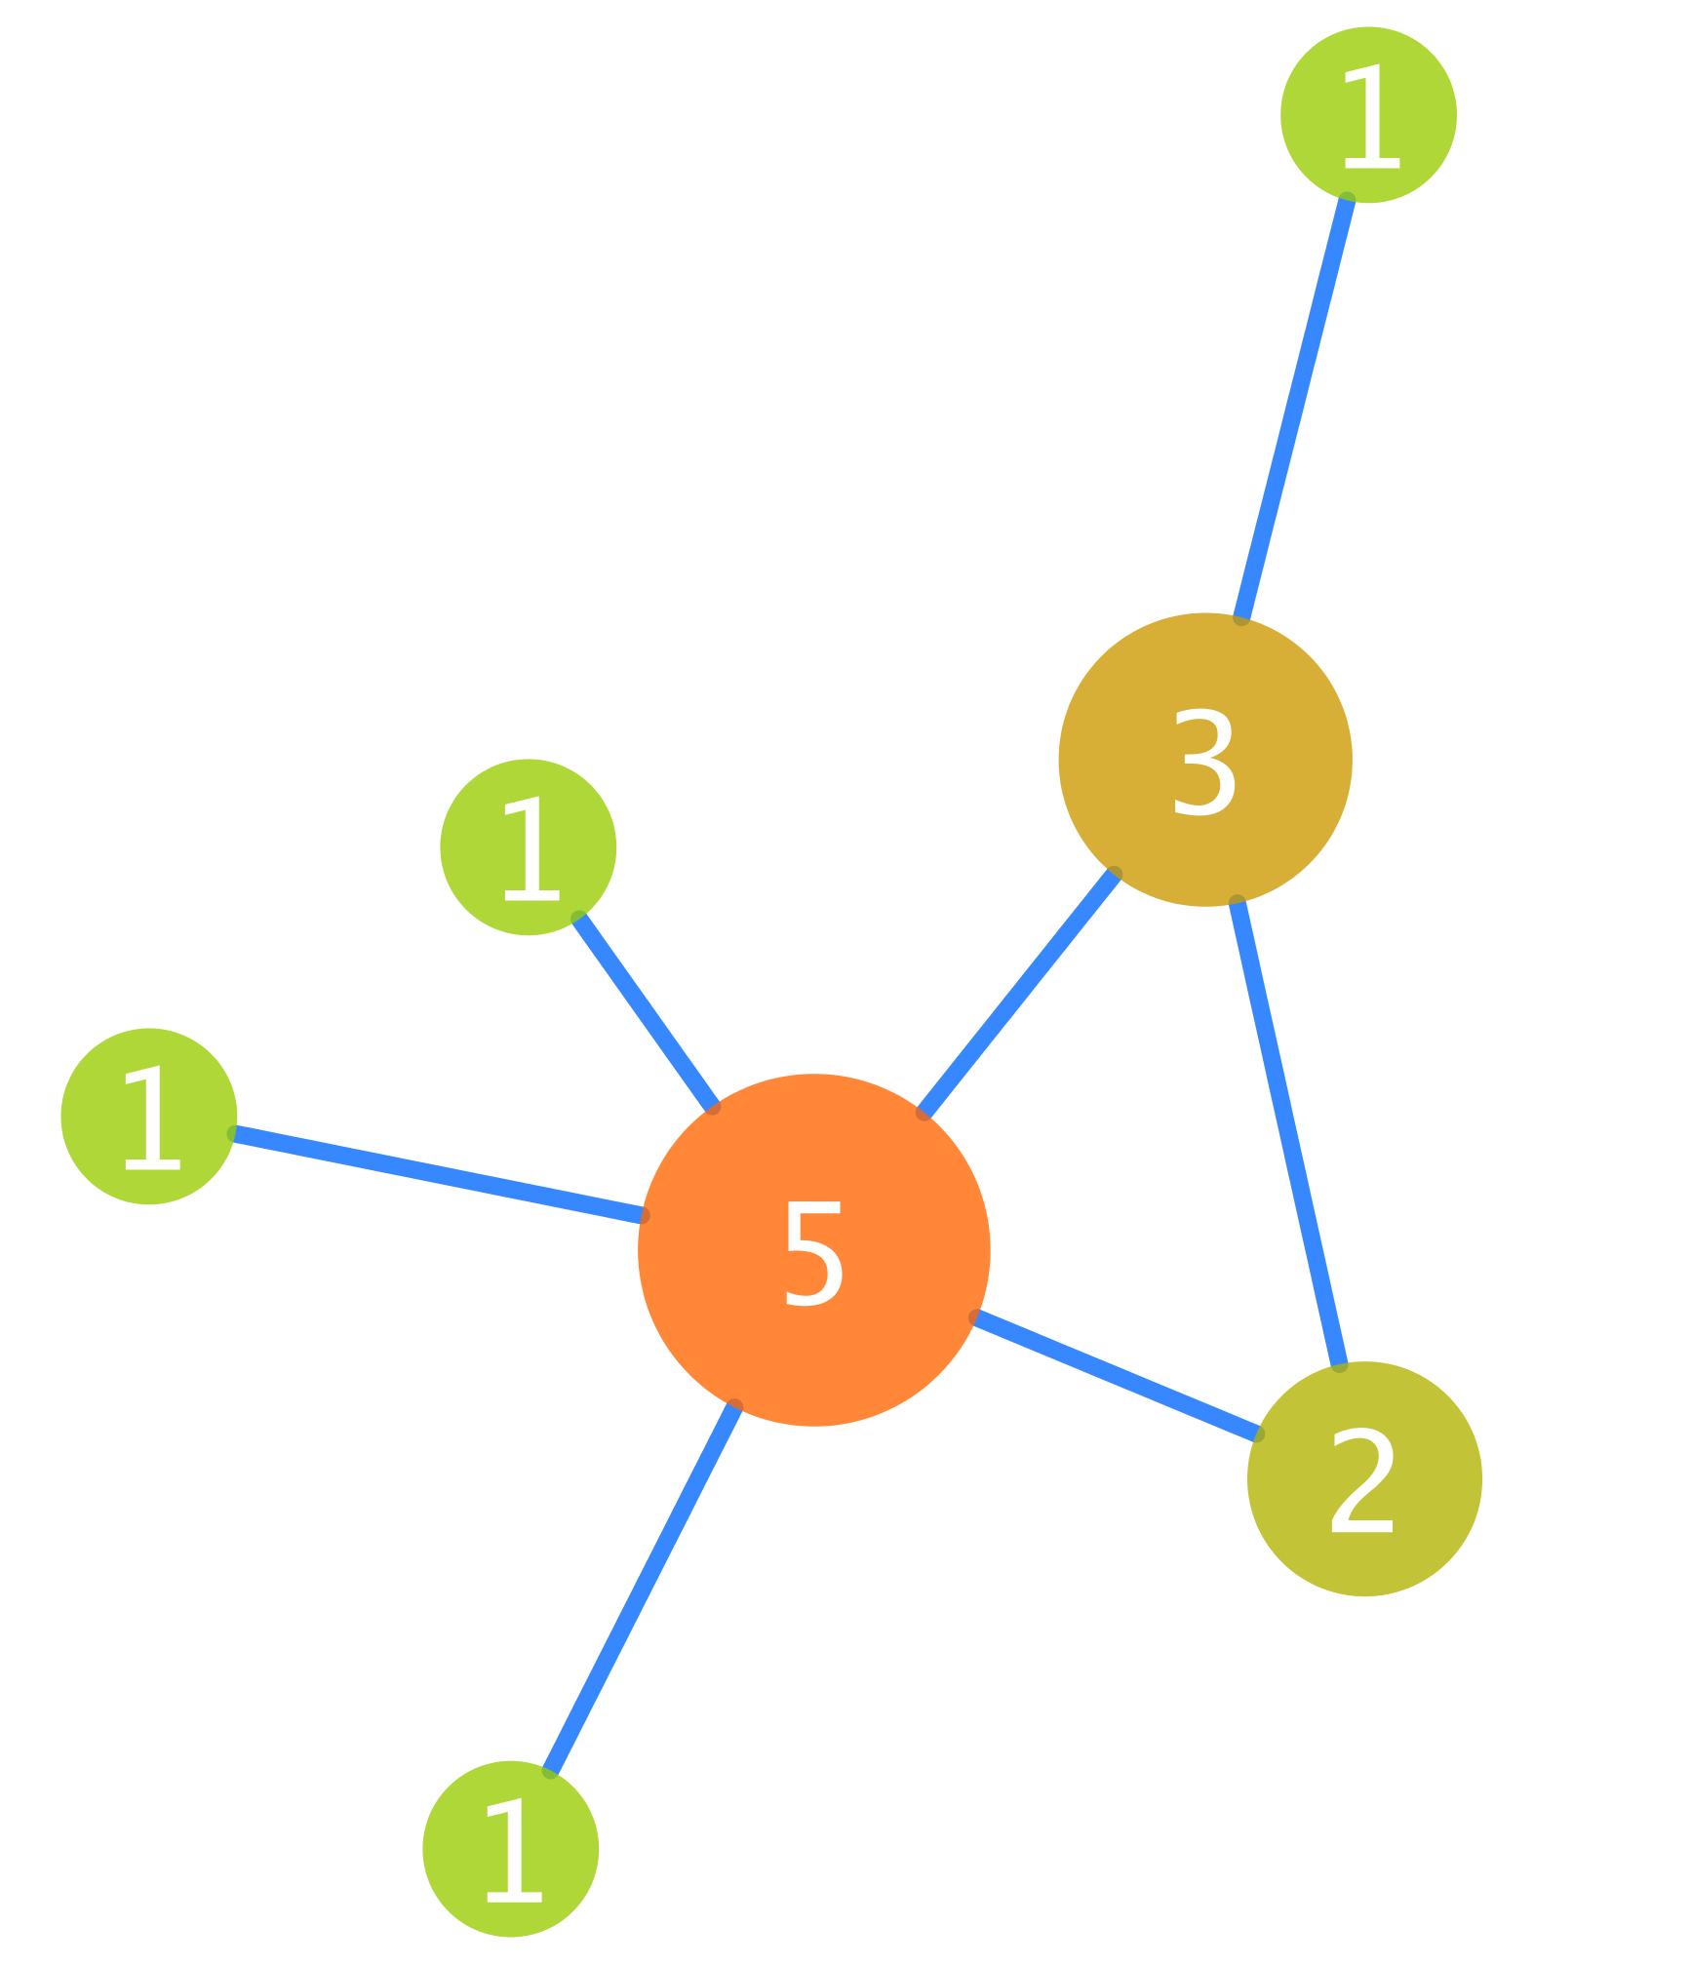
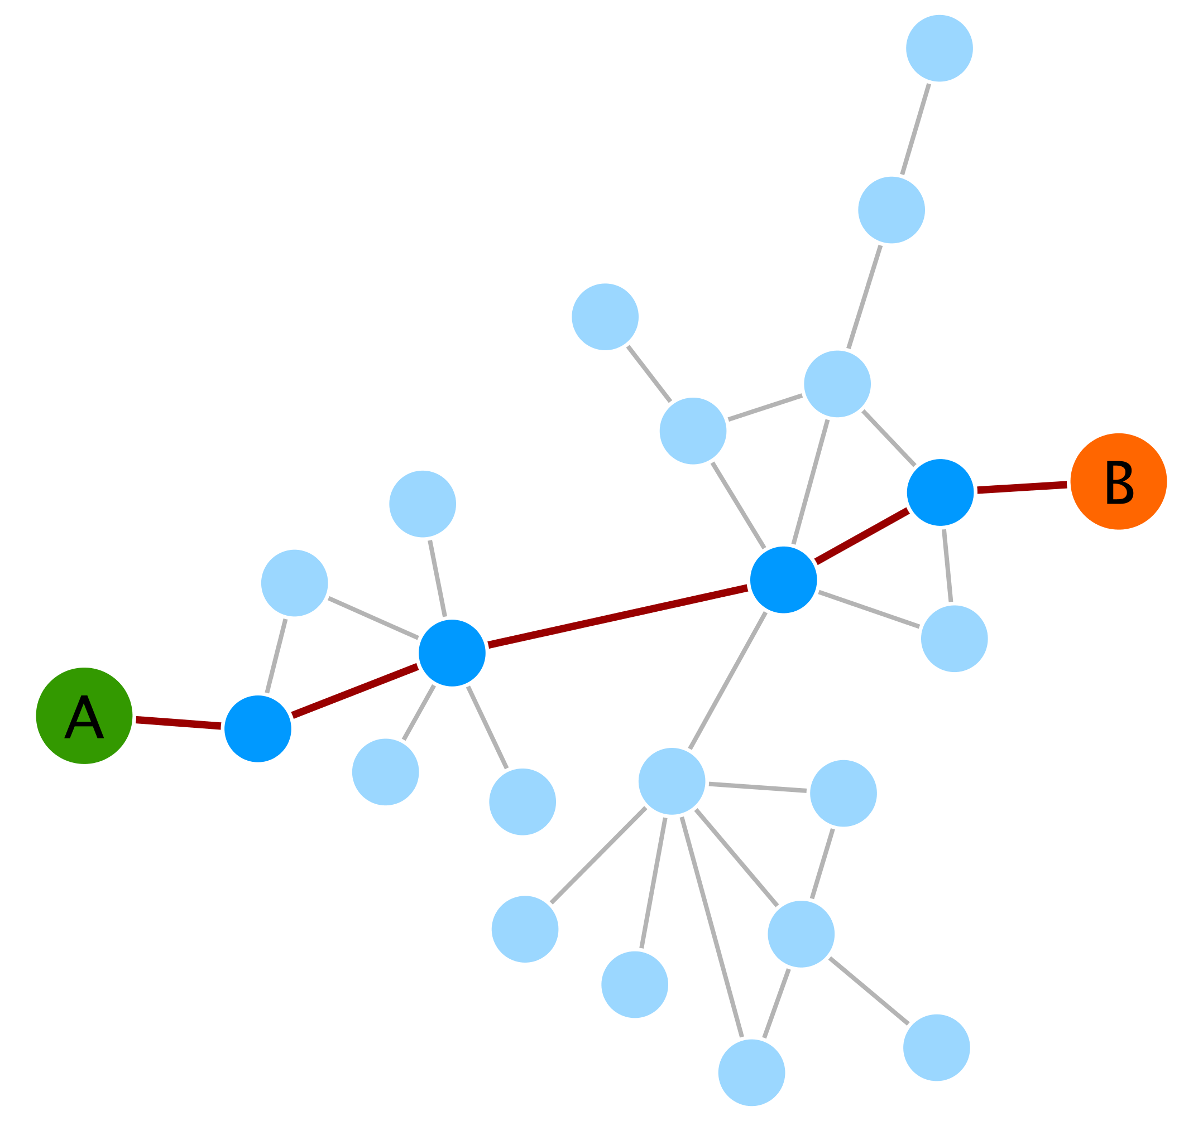
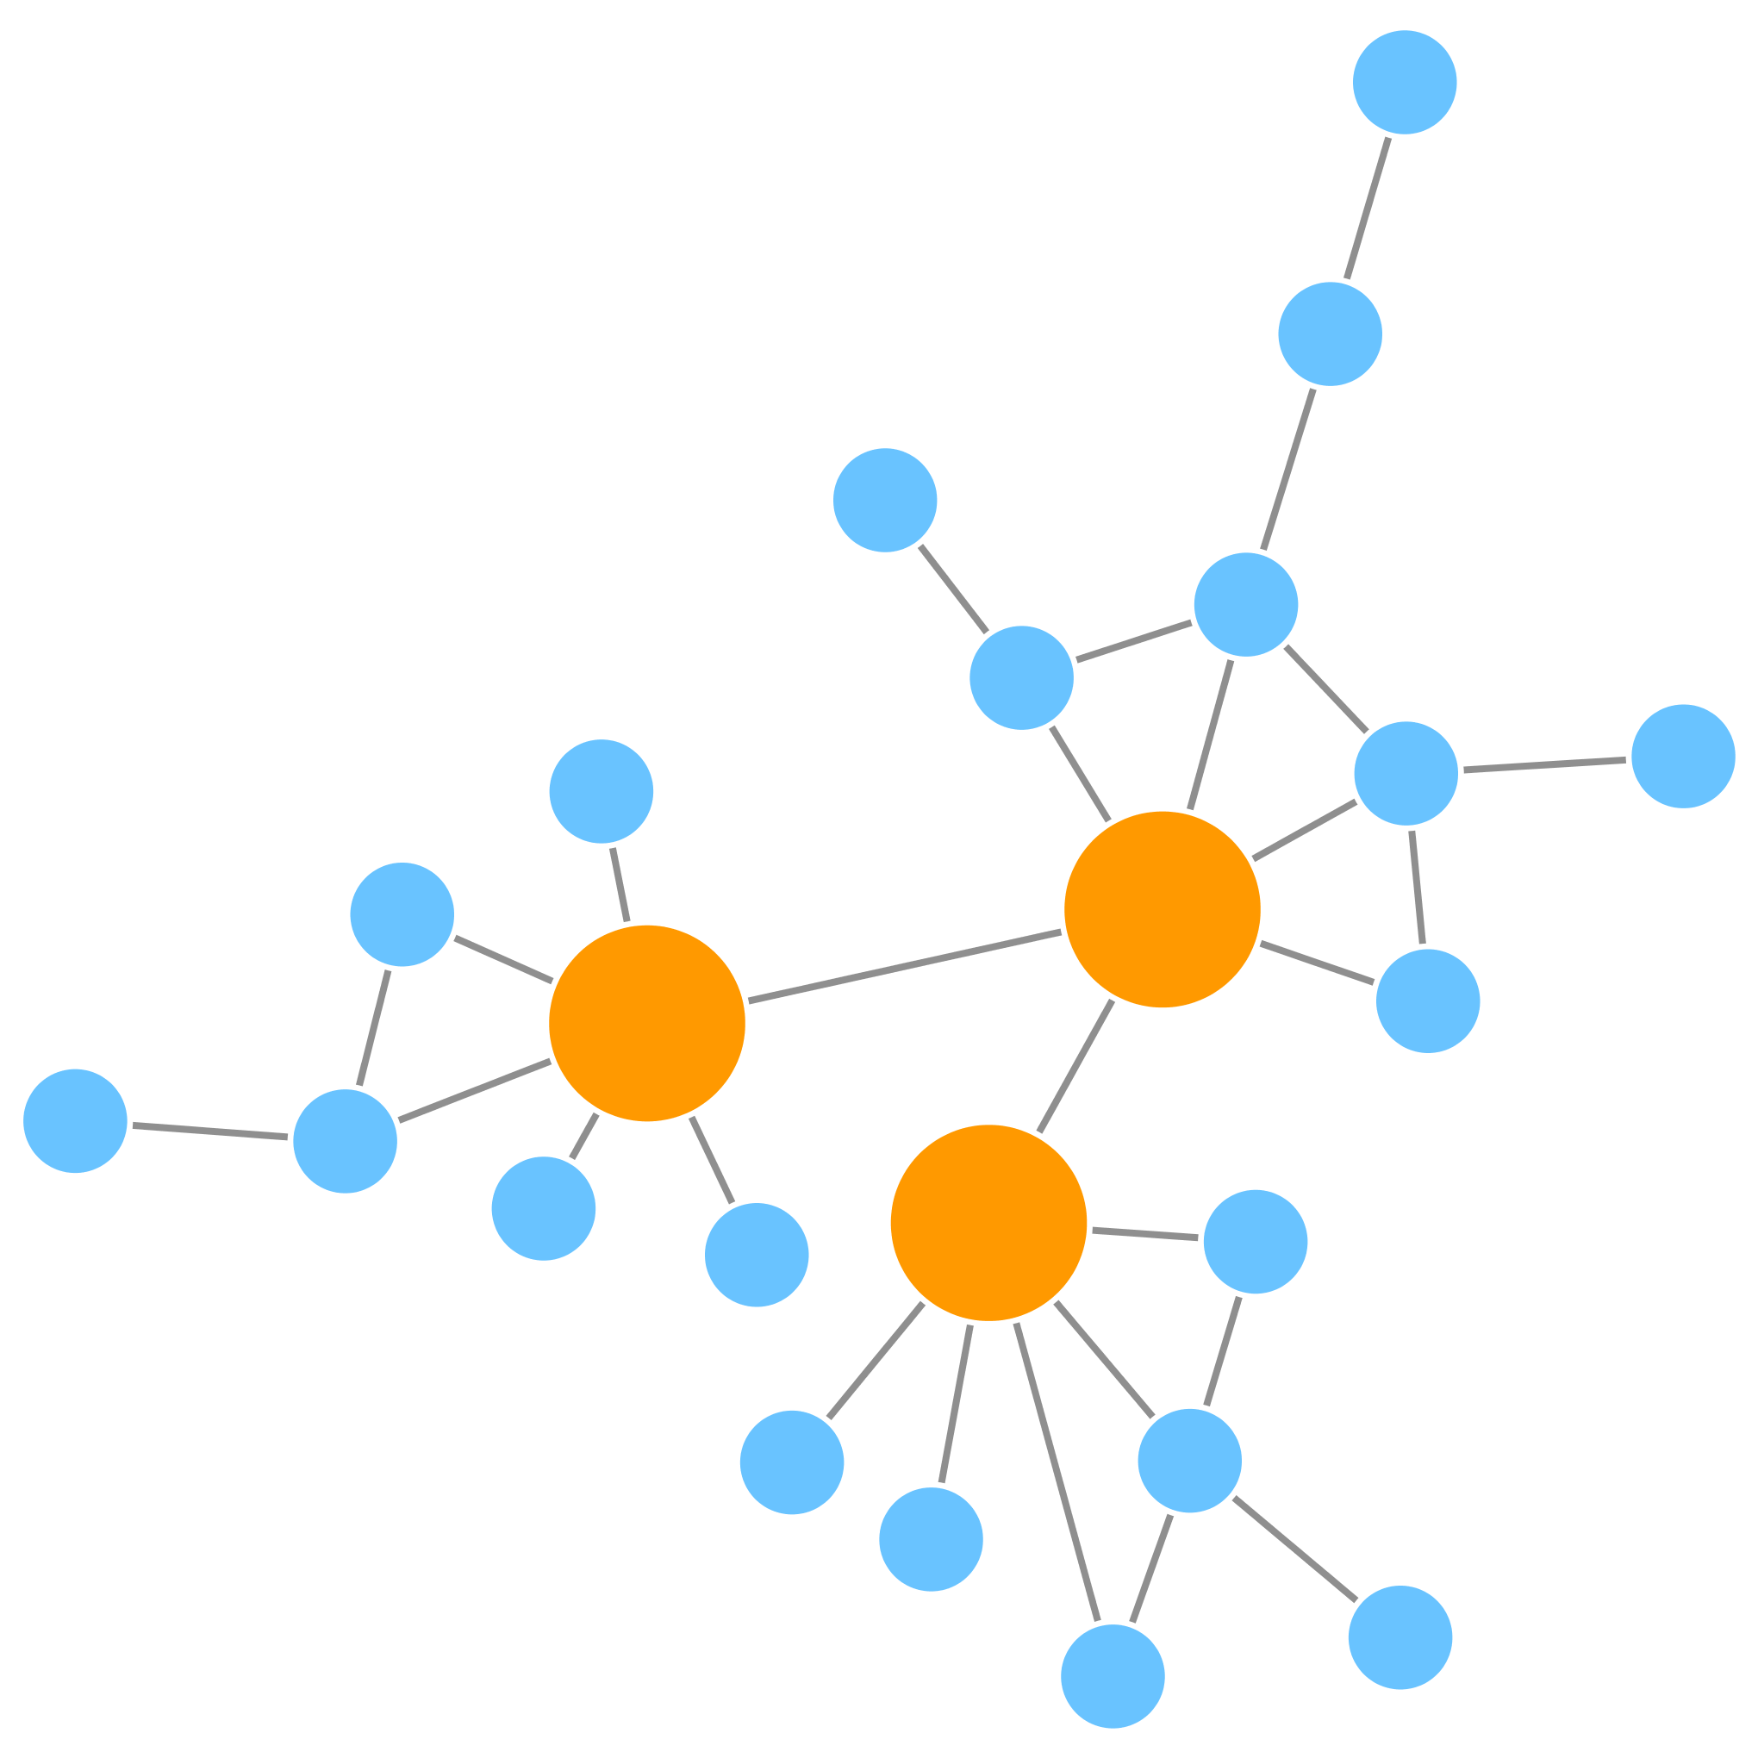
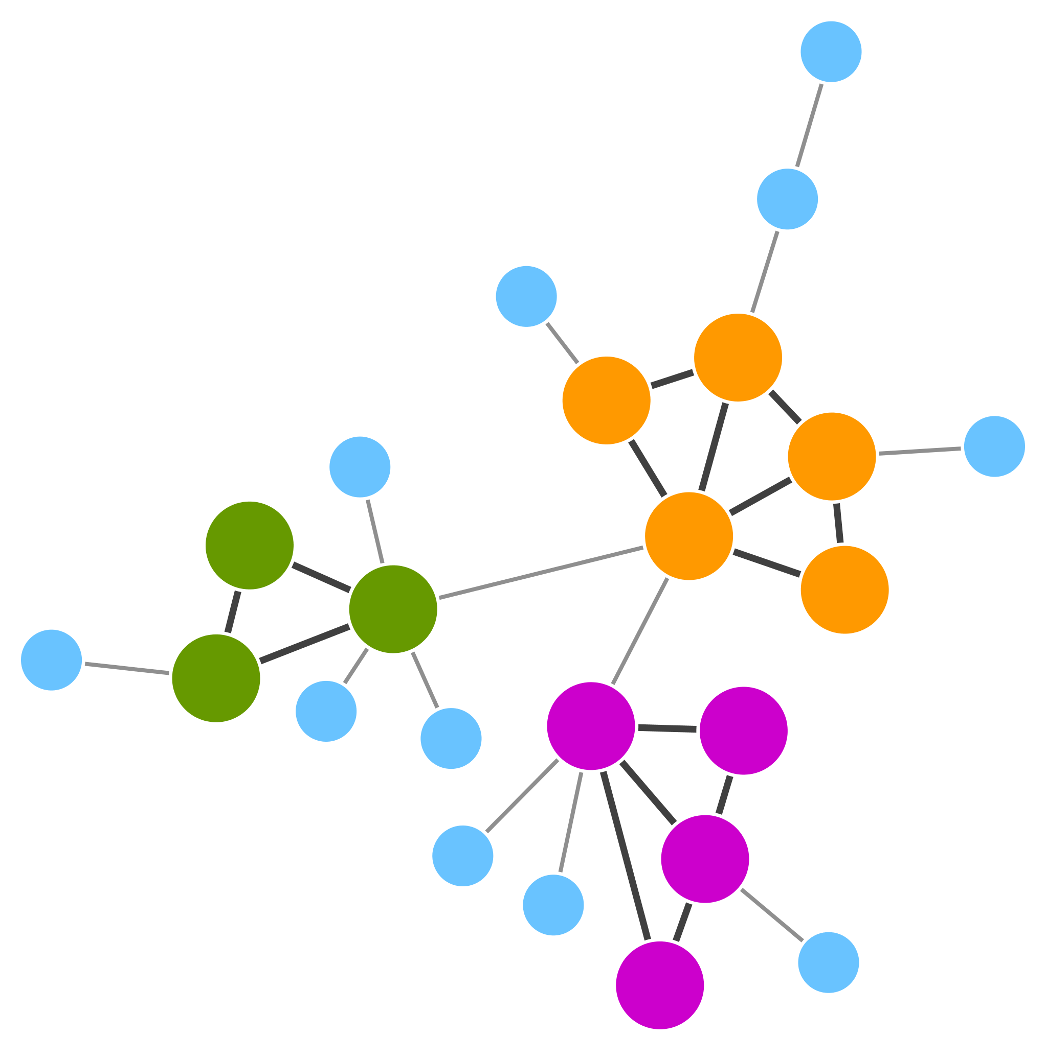
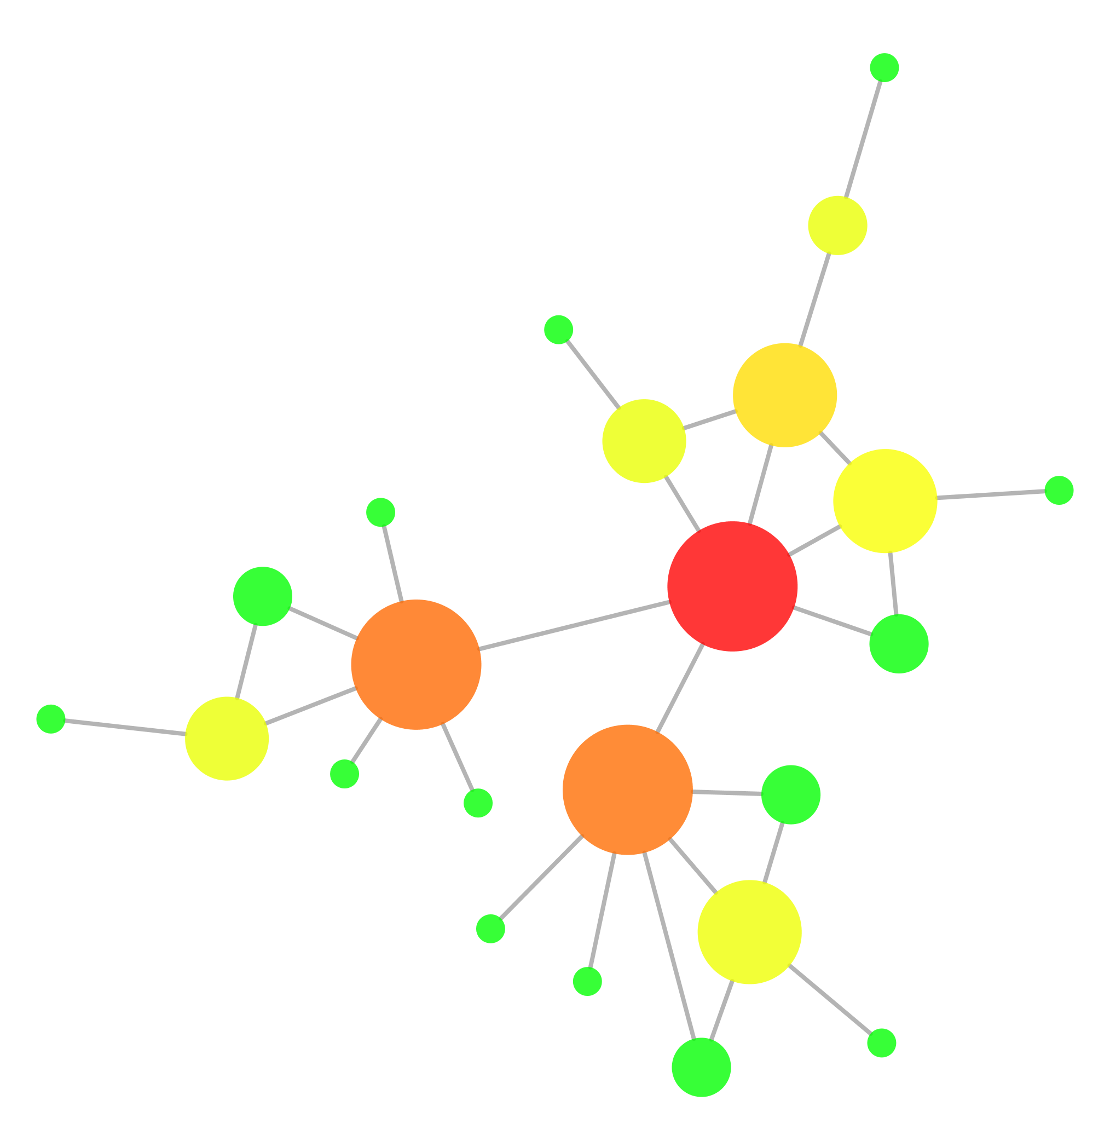
Graph theory: some basic definitions
Degree
Shortest paths
Scale-free network
Transitivity
Centrality
Notes:
Graphs have some properties that have great applicability when it comes to unravel the underlying information they contain. It is important to realize that main issue with any type of network analysis is to handle the complexity of the network and be able to extract meaningful information that you would not have if the individual components are examined separately. Network properties, and particularly its topological properties, can help us identifying relevant sub-structures within an network.
[fig6]
Some of the most used properties and concepts are illustrated in figure 6 and summarized here:
Degree: It is the number of edges that connect a node. It is a fundamental parameter that influences other characteristics, such as the centrality of a node. The degree distribution of all nodes in the network helps defining whether a network is scale-free or not, as we will see later. In the image, you can see the degree of each node indicated and reflected in its size and colour.
Shortest paths: The shortest distance between any two nodes in the network. It is specially relevant in networks that aim to model information flows, as it will often be the case for biological networks. In the example, you have to take 5 steps to go from nodes A to B.
Scale-free networks: In a scale-free network, most of the nodes are connected to a low number of neighbours and there is a small number of high-degree nodes (hubs) that provide high connectivity to the network. In the example, hubs are highlighted in orange.
Transitivity: There are tightly interconnected communities inside the network, groups of nodes that are more internally connected than they are with the rest of the network. These groups are also called topological clusters and are highlighted in the example.
Centralities: As we will see later, there are different flavours of centrality, each representing different concepts. Centrality can be measured for nodes and for edges and gives an estimation on how important that node/edge is for the connectivity or the information flow of the network. The degree of a node has a direct influence on most centralities measures, most prominently on the ‘degree centrality’, which is no more that the degree that given node. In the figure, most central nodes according to their betweenness centrality are highlighted in warm colours and the node size reflects its degree.
Now let’s have closer look at these characteristics and their implications for the biology represented by the network.

Slide 18
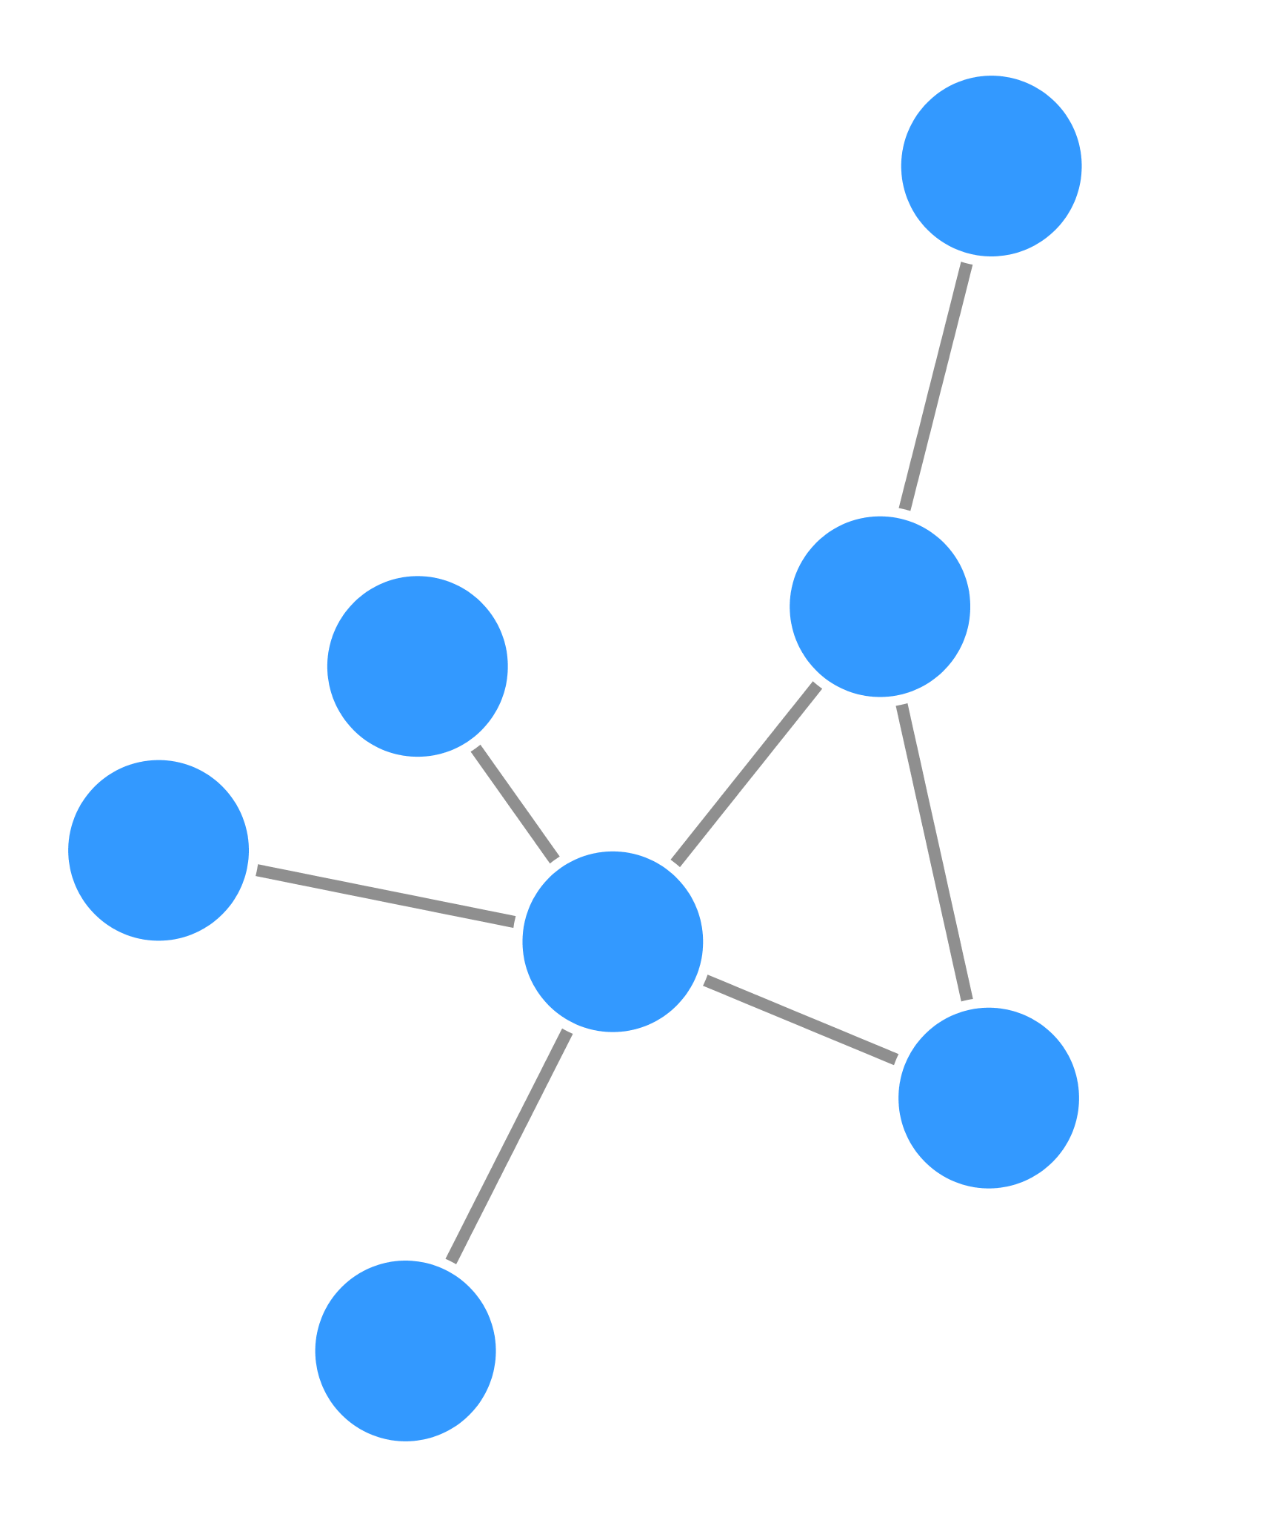
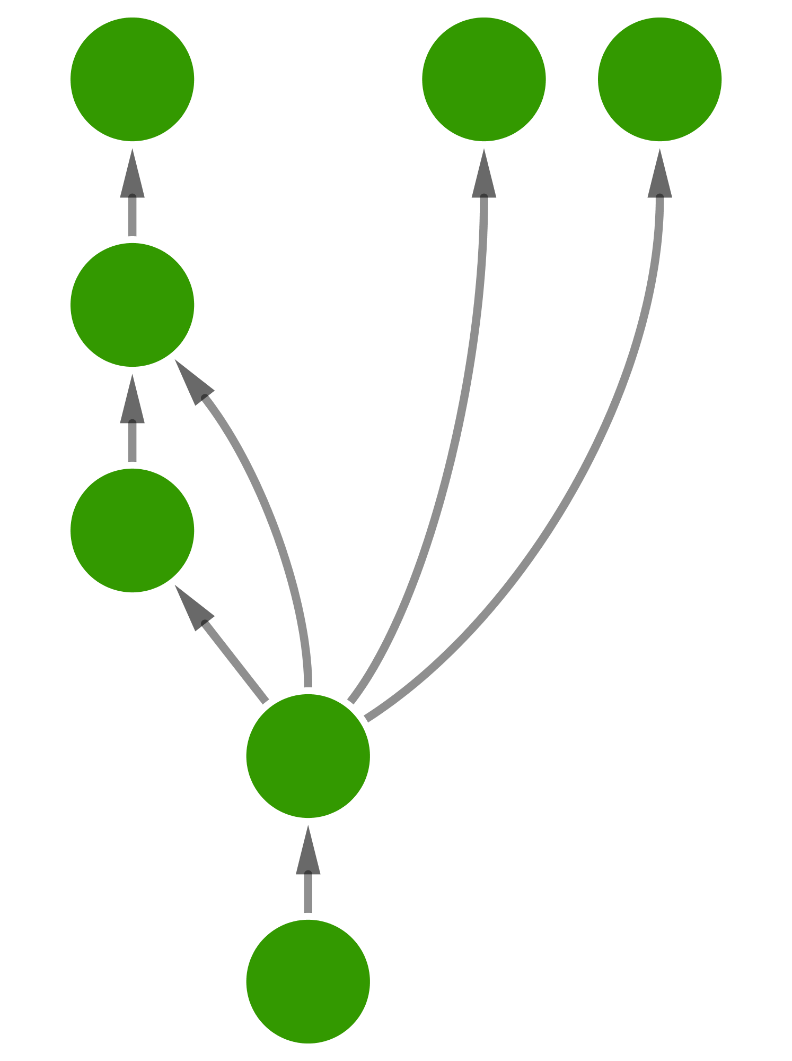
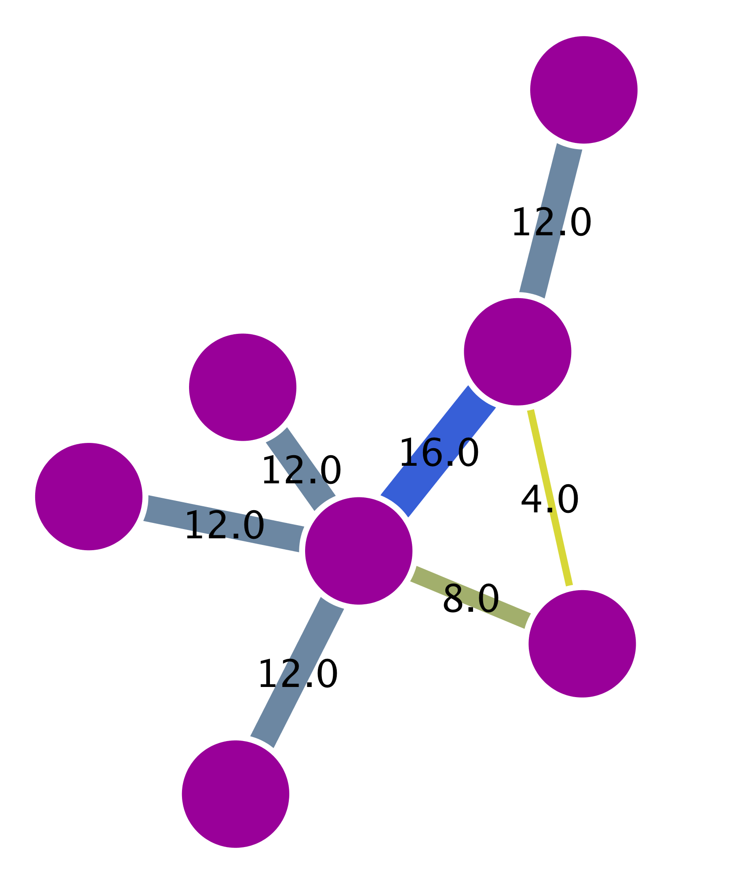
Graph types depending on edge properties
Undirected
Directed
Weighted
G
E
F
G
G
D
E
F
E
F
C
D
A
D
B
A
B
B
C
A
C
 | A | B | C | D | E | F | G
A | 0 | 1 | 1 | 1 | 1 | 1 | 0
B | 1 | 0 | 0 | 0 | 0 | 1 | 0
C | 1 | 0 | 0 | 0 | 0 | 0 | 0
D | 1 | 0 | 0 | 0 | 0 | 0 | 0
E | 1 | 0 | 0 | 0 | 0 | 0 | 0
F | 1 | 1 | 0 | 0 | 0 | 0 | 1
G | 0 | 0 | 0 | 0 | 0 | 1 | 0
Degree
 | A | B | C | D | E | F | G
A | 0 | 1 | 0 | 0 | 0 | 0 | 0
B | 0 | 0 | 1 | 1 | 0 | 1 | 1
C | 0 | 0 | 0 | 1 | 0 | 0 | 0
D | 0 | 0 | 0 | 0 | 1 | 0 | 0
E | 0 | 0 | 0 | 0 | 0 | 0 | 0
F | 0 | 0 | 0 | 0 | 0 | 0 | 0
G | 0 | 0 | 0 | 0 | 0 | 0 | 0
Degree
 | A | B | C | D | E | F | G
A | 0 | 8 | 12 | 12 | 12 | 16 | 12
B | 8 | 0 | 0 | 0 | 0 | 4 | 0
C | 12 | 0 | 0 | 0 | 0 | 0 | 0
D | 12 | 0 | 0 | 0 | 0 | 0 | 0
E | 12 | 0 | 0 | 0 | 0 | 0 | 0
F | 16 | 4 | 0 | 0 | 0 | 0 | 12
G | 12 | 0 | 0 | 0 | 0 | 12 | 0
Degree
5
5
72
2
2
12
1
1
12
1
1
12
1
1
12
3
3
32
1
1
24
Adjacency matrices
Notes:
Networks can represent many different types of data, as we have seen already. Apart from the nodes representing different entities (proteins, genes, people…), the edges can convey information beyond a simple link between nodes. Depending on the nature of this information, different types of analysis can be performed. For this reason, it is useful to highlight the main types of edges that can be found in a network.
[fig5]
Undirected edge: This is the typo of edge we will find in PPINs. The relationship between the nodes is a simple connection, without a given flow of signal implied.
Directed edges: This is the kind of connection you will find in metabolic networks or gene regulation networks, for example. There is a clear flow of signal implied and the network can then be organized hierarchically.
Weighted edges: directed or undirected edges can also have weight or quantitative value associated with them. This is used to depict concepts such a reliability of an interaction, the quantitative expression change that a gene induces over another or even how closely related are two genes in terms of sequence similarity or even expression values. Edges can also be weighted by their centrality values or several other topological parameters.
Finally, it is important to point out that every network can be expressed mathematically in the shape of an adjacency matrix, where the row and columns get assigned to the nodes in the network and the presence of an edge is symbolized by a numerical value. A network with undirected, unweighted edges will only contain the values 1, when a connection is present between the nodes represented by the given row and column, and 0, when there is no connection. Directed and weighted networks can make use of different numerical values in the matrix to express these more complex relationships.
Matt: The underlying mathematical representation of every network is an adjacency matrix, which for undirected networks is characteristically symmetric. Thanks to this representation we can calculate network properties such as degree (shown) and other centralities (later slides) very easily by applying basic concepts from linear algebra.

Slide 19
Example of a PPI Network
Undirected edges
>80% of proteins are all connected in one giant cluster of PPI network
Small-world effect median network distance – 6 steps
Nodes – proteins
Edges – interactions

Slide 20
Properties of PPINs: Small-world effect
Small world effect - Interconnected binding networks could indiscriminately spread perturbations, how individual pathways can be turned on and off without upsetting the whole system ?
Notes:
As we said before, a network showing a small world effect has great connectivity between its nodes. In other words, it can be said that its diameter (the maximum number of steps separating any two nodes) is small, no matter how big the network is. This usually translates in any two nodes being separated by less than 6 steps, more or less, reflecting the now widely popularized “six degrees of separation” theory used in social sciences.
[fig7]
Such connectivity has important biological consequences, since it allows for an efficient and quick flow of signal within the network. However, it also poses an interesting question: if the network is so tightly connected, how come perturbations in a single node do not have dramatic consequences for the network? Biological systems are extremely robust and can cope with a relatively high amount of perturbations in single genes/proteins. In order to explain how can this happen, we need to have a look at another fundamental property of PPINs: they are scale-free networks.

Slide 21
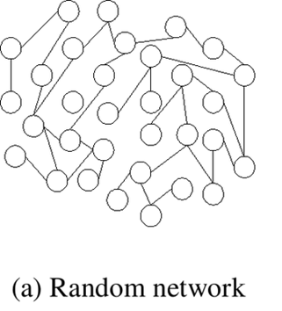
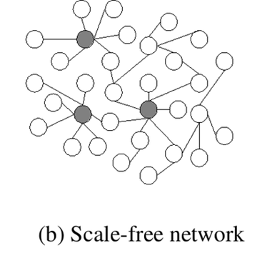
Properties of PPI networks: scale-free networks
Scale-free effect - the majority of nodes in a scale-free network have only a few connections to other nodes, whereas some nodes (hubs) are connected to many other nodes in the network

Slide 22
Properties of PPI networks: scale-free networks
Scale-free networks are stable - if failures occur at random and the vast majority of proteins are those with a small degree of connectivity, the likelihood that a protein hub would be affected is small.
Even if a hub-failure occurs, the network will generally not lose its connectedness, due to the remaining hubs.
However, if we loose a few major hubs from the network, the network is turned into a set of rather isolated graphs (so they are vulnerable to targeted attack).
Many cancer-linked proteins are hub proteins (e.g. P53).
Given the current limited coverage levels and variable quality of interaction data, the observed scale-free topology of existing interactome maps cannot be confidently extrapolated to complete interactomes.

Slide 23
Properties of PPI networks: centralities
Betweenness centrality:
One type of measure of a node's centrality in a network.
Number of shortest paths from every end of the network that pass through that node.
Gives a good estimation of the importance of a node (protein) in a network (signalling, scaffolding…).

Slide 24
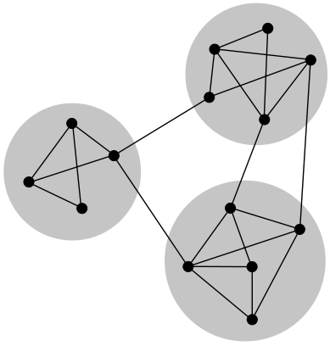
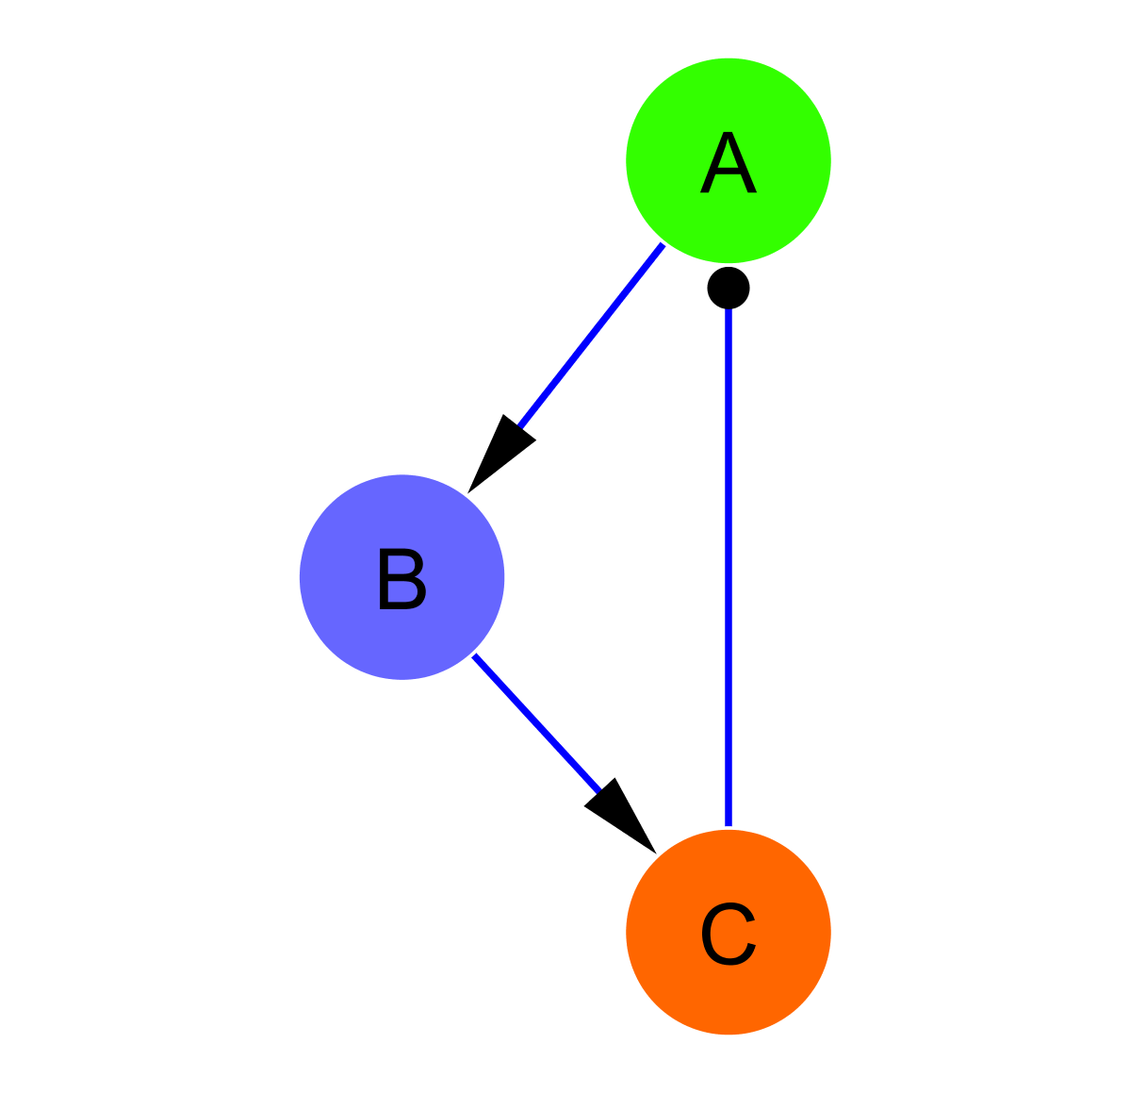
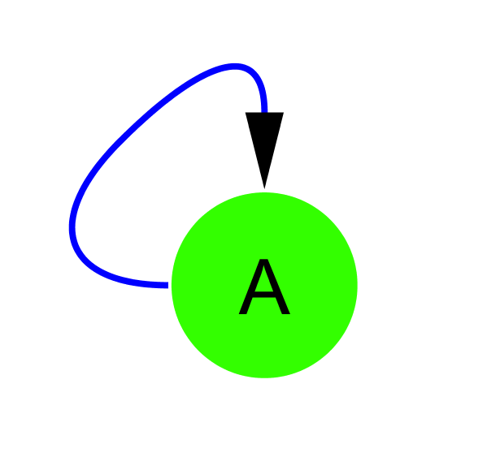
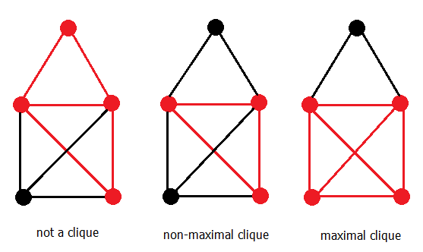
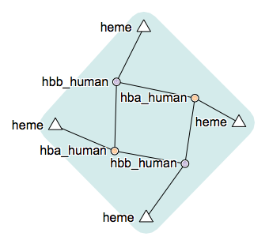
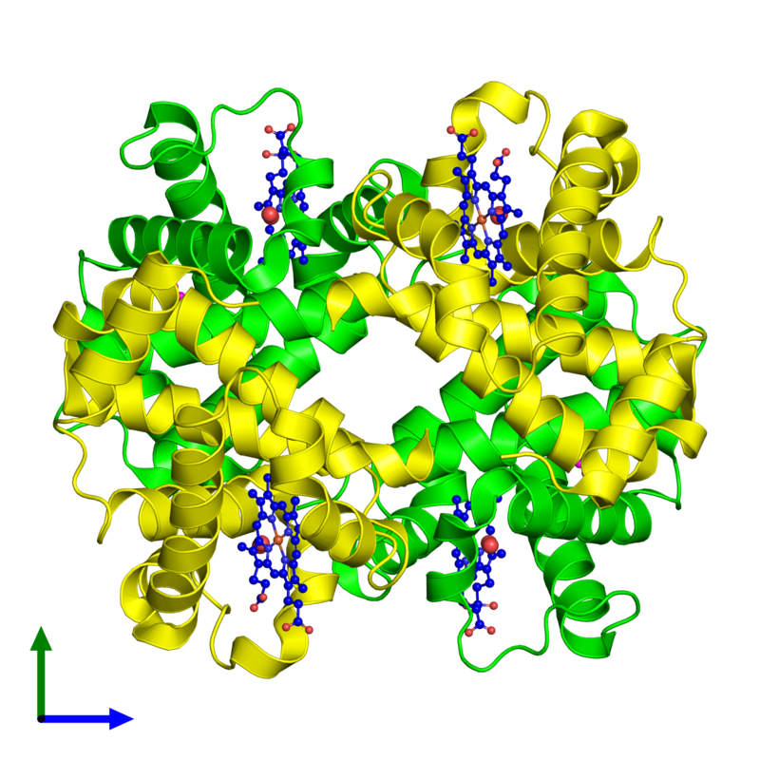
Properties of PPI networks: communities
Motifs
Network
communities
Cliques
Protein
complexes
Network communities figure by j_ham3 - Own work, CC BY-SA 3.0, https://commons.wikimedia.org/w/index.php?curid=17125894
Hemoglobin 3D structure from http://www.ebi.ac.uk/pdbe/entry/pdb/2dn1 and complex diagram from http://wwwdev.ebi.ac.uk/intact/complex/details/EBI-9008420
Notes:
As we have stated before, looking for communities in a network is a nice strategy used to reduce its complexity and extract functional modules reflecting the biology behind it. There are several terms that we will use:
[fig17]
Community / Cluster: A general, catch-all term, it can be defined as a group of nodes that is more connected within themselves than they are with the rest of the network. The precise definition for a community will depend on the method or algorithm used to define it. When talking about PPINs, communities can be classified in two categories: functional modules and protein complexes.
Module: Exchangeable functional unit where the nodes (proteins) involved do not have to be interacting at the same time or space. Its most important characteristic is that when placed in a different context, its intrinsic functional properties do not change.
Complex: Group of proteins that interact together at the same time and in the same space, forming a relatively stable multi-protein machinery.
There are also a couple of terms that you might encounter and that are also useful to understand how clusters are found in a network:
Clique: Subset of nodes where every node is connected with every other member of the clique. A maximal clique is a clique that cannot be extended by adding an additional node not previously included in the clique.
Motif: Statistically over-represented sub-graph in a network. It corresponds to a pattern of connections that generates a characteristic dynamical response (e.g. a negative feedback loop).
When exploring a PPIN for clusters we are often just looking for functional modules or maybe protein complexes that execute defined biological functions. There are many different methods that can help us find clusters, we will briefly introduce a couple of them.

Slide 25
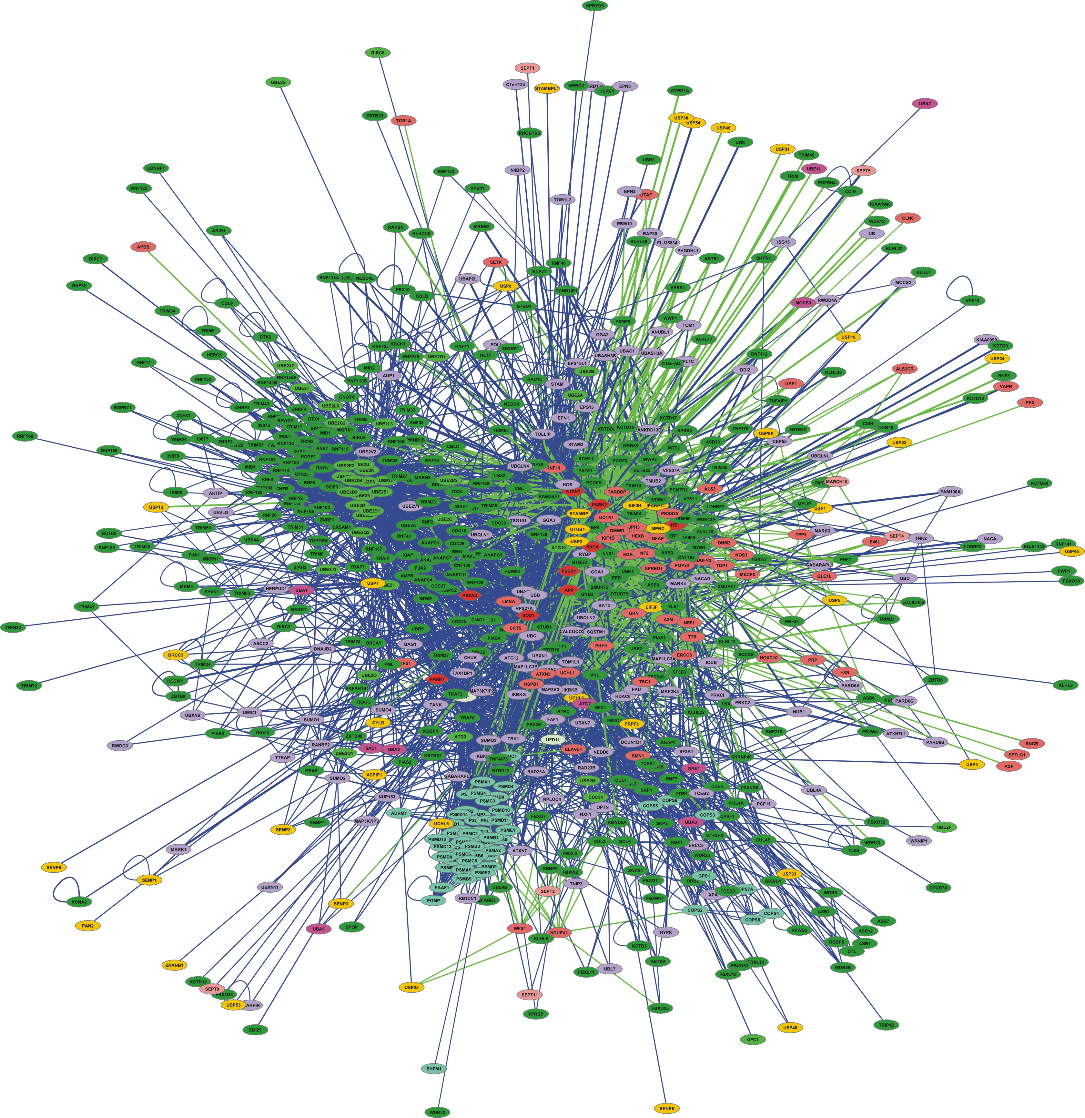

Properties of PPI networks: clustering analysis
Transitivity/ Clustering - A network shows clustering if the probability of pair of nodes being adjacent is higher when the two nodes have a common neighbor.
Functions are likely to be carried out in a highly modular manner.
High clustering => High modularity
Ubiquitin-proteasome system network
Proteasome cluster
Notes:
NOT SO SURE ABOUT THIS ONE, CHECK WITH SANDRA

Slide 26







PPI Network analysis: building a network
primary databases
experimental data
meta-databases and predictive databases
Challenges:
Identifiers
Redundancies
Selection of the data
Type
Quality
Mapping external information

Slide 27


PPI Network analysis: building a network (II) filtering and enriching your data
Confidence filtering
Detection method
Number of publications
Confidence score
...
Overlaying external information
Expression data
Protein abundance
Enzymatic assay values
...

Slide 28
PPIN analysis: the issue of confidence
Figure from Villaveces et al., 2015, PMID:25652942
Notes:
An important concern of researchers when using PPI data is whether the interaction evidence at hand can be trusted to represent a “real” biological interaction. Given the noise inherent to current interactome information, it is key to be stringent when evaluating the base information we are going to use in our analysis. Take into account, however, that interactome coverage is also incomplete and patchy, so often we will not have the luxury of filtering out dodgy evidence from our network.
There are many different methods to ascertain reliability. Some strategies make use of contextual biological information regarding the proteins or molecules involved in the interaction to give some measure of confidence, for example, overlapping co-expression patterns (PMID:15740634, PMID:12118076). A popular and straightforward approach is to just count how many times a given interaction has been reported in the literature, as a measure of experimental orthogonal validation. There are more elaborated variations of such strategy, as we will see in our detailed example. Finally, there are aggregated methods that use a number of different strategies and integrate them in a single score, such as INTscore (http://intscore.molgen.mpg.de/, PMID:22649056)
Just to give a bit more detail about a specific methods, let’s have a look at MIscore (PMID:25652942). MIscore gives an estimation of confidence weighting all available evidence for an interacting pair of proteins. This is possible because the method can be applied to datasets represented following the standards created within the IMEx consortium. As shown in figure 12, the method weights the number of publications, the detection method and the interaction evidence type. Different interaction detection methods and interaction types have also different weights, assigned by a group of expert curators. All these parameters are aggregated for each interacting pair and then normalized, giving a quantitative measure of how much experimental evidence there is behind a given interacting pair.
[fig11]
Now let’s finally have a look at some strategies we can use to extract information from a network.

Slide 29



Annotation enrichment analysis
GO:0019908:
nuclear cyclin-dependent protein kinase holoenzyme complex
REACT_821.2:
Cyclin D associated events in G1
Notes:
As we introduced before, annotation enrichment analysis uses gene/protein annotations provided by knowledge-bases such as GO or Reactome to infer which annotations are over-represented in a network. Essentially, the tools available perform some type of statistical test (usually a hypergeometric test, often also a binomial test) that tries to answer the following question: 'When sampling X proteins (test set) out of N proteins (reference set; graph or annotation), what is the probability that x or more of these proteins belong to a functional category C shared by n of the N proteins in the reference set.¹’. The result of this test provides us with a list of terms that describe the list/network or rather a part of it as a whole.
[fig 13]
This type of analysis is most frequently performed using GO annotation as a reference, but tools such as the Cytoscape apps ClueGO and ClueGO can also manage other annotation databases such as Reactome and KEGG [REFS AND LINKS]. This is a widely used technique that helps characterizing the network as a whole or sub-sets of it, such as inter-connected communities found through topological clustering analysis.
The main limitations of this approach come from the annotations themselves. Focusing on GO as an example, certain areas of the ontology are more thoroughly annotated and better described than others, with more detail and more accurate terms for well-known processes. This of course has an impact when performing the statistics and introduces a certain bias.
At the level of the proteins annotated there is also a bias, with more "popular" proteins being better annotated. It is also important to know that GO terms are assigned either by a human curator that performs manual, careful annotation or by computational approaches that use the basis of manual annotation to infer which terms would properly describe uncharted gene products. They use a number of different criteria always referred to annotated gene products, such as sequence or structural similarity or phylogenetic closeness. The importance of the computationally derived annotations is quite significant, since they account for roughly 99% of the annotations that can be found in GO.
Finally, the last limitation fo this approach is that often, if you analyze a relatively large network, the results of the analysis are quite complex, since resources such as Reactome and especially GO can be very complex and detailed in their annotation. For that reason, many tools offer the option to use simplified versions of the ontologies where a fine detailed terms are removed and assigned to borader, more general parent terms. In GO in particular, these simplified ontologies are called GOslims.
In summary, it is important to know the annotation resource you are using to perform this type of analysis, as well as to be aware of the limitations of the statistical tool used to perform the test. [NEED TO ADD MORE ON THAT].
http://www.ebi.ac.uk/training/online/course/uniprot-goa-quick-tour
http://www.ebi.ac.uk/training/online/course/go-quick-tour
http://www.ebi.ac.uk/training/online/course/reactome-exploring-and-analysing-biological-pathwa-1
1.- Taken from the website of ClueGO, a Cytoscape app for GO enrichment analysis (http://www.psb.ugent.be/cbd/papers/ClueGO/User_Guide.html).

Slide 30




PPIN analysis: some strategies
Base PPI network
Annotation enrichment
Others:
Shortest paths
Motif search (directed networks)
Integrate external information
…
Centrality analysis
Topological clustering
Notes:
There are many different strategies used to extract information from a network and these are strongly dependent on the problem at hand and the nature of the data represented, so it would be useless to give a fully comprehensive list. However, there is a number of commonly used tools that are commonly used to analyze PPINs, highlighted in figure 13.
[fig12]
Annotation enrichment analysis: Also known as gene set enrichment analysis (GSEA) uses gene/protein annotations provided by resources such as the Gene Ontology (GO, www.geneontology.org) or Reactome (www.reactome.org) to infer which annotations are over-represented in a list of genes. This can be used in the context of a network or just with a simple list, so it is not strictly speaking a network analysis strategy, but it is often used to analyze either full PPINs or parts of them.
Centrality analysis: As we introduced before, the centrality of a node/edge gives an estimation on how important it is for the connectivity or the information flow of the network. It is a relevant parameter specially in signalling networks and it is often used when trying to find targets for drug treatment.
Topological clustering: Finding interconnected communities inside the network can help us identify functional modules within it.
Other methods: We will not devote much room to explore these strategies, but they are worth mentioning nevertheless.
Shortest paths: Finding the shortest paths between given nodes in a network is a way to highlight the most important routes in the flow of information in the network.
Motif search: Motifs are recurred, statistically significant patterns within a network. They are specially relevant in directed networks, where they can represent small functional entities, such as a positive feedback loop, for example.
Integrate external information: A fundamental part of any network analysis is the need to overlay information external to the network, such as expression data, variant annotation, quantitative proteomics data, etc… Integrating this information allows to identify sub-regions in the network with a given expression pattern, for example.

Slide 31




PPI Network representation challenges
Blisson et al., 2011, Nature Biotechnology, PMID: 21706016.

Slide 32
The problem of data integration and an example of a solution: PSICQUIC
Sandra Orchard &
Pablo Porras Millán, IntAct
orchard@ebi.ac.uk
pporras@ebi.ac.uk

Slide 33
Molecular interaction information
Ideally
Reality
DB
DB
DB
DB
DB
I
I
I
I
I
Database
I
Interface
User
Notes:
As a biologist I would prefer to see all the information in one unique database.
Centralized databases have this mission.
The aim to collect all the information for one specific domain.
However …
Medium-size labs and organizations are capable to produce large amounts of data.
Then it becomes harder to submit data to centralized repositories.
Moreover data producers like to control and structure their own databases, developing their own GUI and access protocols.
For us, the users, it becomes harder to access the information.
For one specific domain we might find different databases, using different GUIs. We might end up downloading data in different formats complicating the integration of results. After integration we might find a problem of high redundancy in our results.

Slide 34

Molecular interaction resources
547 resources!
www.pathguide.org/

Slide 35
Data integration
Combining data residing in different sources
… providing users with a unified view of these data.
Ideally
Reality
Compromise
DB
DB
DB
DB
DB
DB
DB
DB
DB
I
I
I
I
I
STANDARDS AND ONTOLOGIES
I
Database
I
Interface
User

Slide 36
Data integration problems
Many data resources
Many to maintain
New appearing
Just 20% has a sustained future*
Not easy to find them
Different query interfaces
Variable results
Formats
Schemas
Controlled vocabularies
Minimum information guidelines
Redundancy
Inconsistency
data integration?
* Merali et al., 2005, Nature, PMID: 15973369.

Slide 37


Standards
PSI-MI standards
Common identifiers
Controlled vocabularies
Common formats
Common schemas
Minimum information guidelines
Common query interfaces
www.psidev.info/MI
Control vocabulary
Schema
Format
Identifiers
Reporting
guideline
Data distribution
Notes:
The Molecular Interactions workgroup is concentrating on:
improving the annotation and representation of molecular interaction data wherever it is published, be this in journal articles, authors web-sites or public domain databases
improving the accessibility of molecular interaction data to the user community. By using a common standard data can be downloaded from multiple sources and easily combined using a single parser

Slide 38

The danger with standards…
From xkcd: http://xkcd.com/927/

Slide 39
Collaboration among data providers
More data coverage
Less redundancy
Less inconsistency
Better data management
Access, exchange, sharing, portability, interoperability, annotation, comparison, verification, representation, integration, reusability.
IntAct
PRIDE
ENA
…
…
InnateDB
GPMDB
GenBank
DDBJ
MINT
Tranche
DIP
PeptideAtlas
Nucleotide sequences
INSDC
Molecular interactions
IMEx
Protein indentifications
ProteomeXchange

Slide 40






Unified query client: PSICQUIC
www.ebi.ac.uk/Tools/webservices/psicquic/view/main.xhtml
PSI-MI
MIQL
Interactions
Query
input
output
PSICQUIC
PSICQUIC
Service A
PSICQUIC
Service B
PSICQUIC
Service C
PSICQUIC
Registry

Slide 41









Examples of services using PSICQUIC
www.phisto.org
www.reactome.org
www.cytoscape.org
www.genemania.org
http://mentha.uniroma2.it
http://clipserve.clip.ubc.ca/topfind
http://cbdm.mdc-berlin.de/tools/hippie
www.ebi.ac.uk/Tools/webservices/psicquic/view/main.xhtml
www.bioconductor.org/packages/release/bioc/html/PSICQUIC.html

Slide 42

Unified query client interface: PSICQUIC view
www.ebi.ac.uk/Tools/webservices/psicquic/view/main.xhtml

Slide 43

Unified query client interface: PSICQUIC view

Slide 44

Unified query client interface: PSICQUIC view

Slide 45

Unified query client interface: PSICQUIC view

Slide 46

Unified query client interface: PSICQUIC view

Slide 47

PSICQUIC registry
www.ebi.ac.uk/Tools/webservices/psicquic/registry/registry?action=STATUS

Slide 48
PSICQUIC GAME
www.biotnet.org/training-materials/psicquic-game

Slide 49
Service Oriented Architecture
Services
IntAct
Biogrid
String
...
Registry
Clients
PSICQUIC view
Cytoscape
…
PSICQUIC Registry
Find
Publish
Format
DAS Clients
PSI-MI
PSICQUIC
sources
DAS Clients
PSICQUIC
sources
PSICQUIC
Clients
PSICQUIC
Services
query
MIQL
49
17.05.17

Slide 50
User
Query
P2 or P6
LIM15 RAD51

Slide 51
Software/Client

Slide 52
Registry
Service Name | Service location

Slide 53
Service A
Name: ……………..…….
Molecule A | Molecule B | Detection method
P1 | P2 | Two hybrid
P2 | P2 | Coip
P3 | P4 | Coip
P3 | P5 | Coip

Slide 54
Service B
Name: ……………..…….
Molecule A | Molecule B | Detection method
P6 | P6 | Two hybrid
P7 | P9 | Coip
P8 | P6 | Coip
P9 | P10 | Coip

Slide 55
Service C
Name: ……………..…….
Molecule A | Molecule B | Detection method
P2 | P12 | Two hybrid
P6 | P12 | Coip
P11 | P9 | Coip
P6 | P4 | Coip

Slide 56
Service D
Name: ……………..…….
Molecule A | Molecule B | Detection method
P15 | P2 | Two hybrid
P6 | P6 | Coip
P14 | P13 | Coip
P15 | P2 | Coip

Slide 57
Solution
P8
P1
P2
P12
P6
P15
P4

Slide 58
Solution
Services
P8
P1
A
B,D
A
B
P2
C
P12
C
P6
D
C
P15
P4

Slide 59
Solution
Detection methods
P8
P1
Coip
Coip, Two Hybrid
Two Hybrid
Coip
P2
Two Hybrid
P12
Coip
P6
Coip, Two Hybrid
Coip
P15
P4

Slide 60
Introduction to Cytoscape

Slide 61



Cytoscape: open-source network representation and analysis tool
www.cytoscape.org
2.8
3.5

Slide 62

Representing PPIs: Why Cytoscape?
www.cytoscape.org
It imports molecular and genetic interaction datasets in several formats.
We will import data from IMEx-complying databases to generate a molecular interaction network using the PSICQUIC Universal Client app of Cytoscape.
It can make use of several visual features that can effectively highlight key aspects of the network.
We will use node and edge columns to represent quantitative proteomics data and interaction features.
It can integrate global datasets and functional annotations.
We will make use of resources such as the Gene Ontology to annotate the interacting partners in our network.
It has a wide variety of advanced analysis and modelling tools in the form of apps that can be easily installed and applied to different approaches.
The ClueGO and MCODE apps will be used to perform GO enrichment analysis and try to identify the functional modules underlying our network.

Slide 63

Cytoscape apps/apps
Large variety of apps/plugins (>300)
Great flexibility, adaptable to multiple types of analysis, in various domains of knowledge: bioinformatics, social network analysis, semantic web…
Possibility to create your own.
Some deprecated or obsolete
Different functionality depending on the Cytoscape version
“A travel guide to Cytoscape plugins.”
Saito et al., 2012, Nature Methods, PMID: 23132118.

Slide 64
Building and analyzing networks with Cytoscape and PSICQUIC

Slide 65
Workflow
Obtain protein-protein interactions
PSICQUIC-based interaction import client in Cytoscape
Visualize network
Cytoscape
Basic network analysis
Filtering your network based on columns
Cytoscape: Using filters
Integrate brain expression information in the network
Cytoscape: Load columns
Eliminating duplicated edges and self-loops
Identify heavily connected sub-networks
Cytoscape: MCODE app
Analyze meaningful GO annotation
Cytoscape: ClueGO app

Slide 66

Workflow
Base PPI network
List of proteins (seed)
Topological clustering
Annotation enrichment

Slide 67

Our dataset
https://omim.org/search/advanced/

Slide 68


Our dataset
www.uniprot.org/uploadlists/

Slide 69
Workflow
Obtain protein-protein interactions
PSICQUIC-based interaction import client in Cytoscape
Visualize network
Cytoscape
Basic network analysis
Filtering your network based on columns
Cytoscape: Using filters
Integrate brain expression information in the network
Cytoscape: Load columns
Eliminating duplicated edges and self-loops
Identify heavily connected sub-networks
Cytoscape: MCODE app
Analyze meaningful GO annotation
Cytoscape: ClueGO app

Slide 70


Importing interaction data through PSICQUIC
Cytoscape
File → Import → Network → Public Databases…
copy & paste

Slide 71

Importing interaction data through PSICQUIC
Cytoscape
File → Import → Network → Public Databases…
Select source databases

Slide 72
Importing interaction data through PSICQUIC
IMEx-complying databases
IntAct
MINT
MatrixDB
DIP / DIP-IMEx
I2D-IMEx
UniProt
BHF-UCL
MolCon
InnateDB-IMEx
MBInfo

Slide 73

Importing interaction data through PSICQUIC

Slide 74

Importing interaction data through PSICQUIC

Slide 75
Workflow
Obtain protein-protein interactions
PSICQUIC-based interaction import client in Cytoscape
Visualize network
Cytoscape
Basic network analysis
Filtering your network based on columns
Cytoscape: Using filters
Integrate brain expression information in the network
Cytoscape: Load columns
Eliminating duplicated edges and self-loops
Identify heavily connected sub-networks
Cytoscape: MCODE app
Analyze meaningful GO annotation
Cytoscape: ClueGO app

Slide 76

Visualizing the network
1
2

Slide 77

Visualizing the network
Layout → yFiles Layouts → Organic

Slide 78

Find a layout that sorts your network nodes by the number of interactions that each one of them has.

Slide 79
Workflow
Obtain protein-protein interactions
PSICQUIC-based interaction import client in Cytoscape
Visualize network
Cytoscape
Basic network analysis
Filtering your network based on columns
Cytoscape: Using filters
Integrate brain expression information in the network
Cytoscape: Load columns
Eliminating duplicated edges and self-loops
Identify heavily connected sub-networks
Cytoscape: MCODE app
Analyze meaningful GO annotation
Cytoscape: ClueGO app

Slide 80

Cytoscape: column information
Columns hold information about nodes and edges in Cytoscape.
They can be used to create and apply visual styles, allowing for visualization of complex information, or to select specific groups of nodes/edges that share certain column values.
Node columns
Edge columns
Protein name: pp60c-src
Relative expression value: -3.23
Seed: yes
Protein family: NPK
Interaction detection method: anti-bait coIP
Confidence score: 0.24
Interaction type: physical association
Database: IntAct

Slide 81

Table panel: nodes

Slide 82

Table panel: edges

Slide 83

Using selection / filters
In ‘Control Panel’ go to the ‘Select’ tab

Slide 84


Using selection / filters

Slide 85
Use edge columns to create a network in which all the interactions have been found using the ‘two hybrid’ interaction detection method.

Slide 86
Workflow
Obtain protein-protein interactions
PSICQUIC-based interaction import client in Cytoscape
Visualize network
Cytoscape
Basic network analysis
Filtering your network based on columns
Cytoscape: Using filters
Integrate brain expression information in the network
Cytoscape: Load columns
Eliminating duplicated edges and self-loops
Identify heavily connected sub-networks
Cytoscape: MCODE app
Analyze meaningful GO annotation
Cytoscape: ClueGO app

Slide 87


Our dataset: columns table
brain_ensembl2upac_cyt.txt
gxa_ibm_brain_exp.txt

Slide 88

Importing columns to Cytoscape
File → Import → Table → File…

Slide 89

Importing columns to Cytoscape
File → Import → Table → File…

Slide 90
Now repeat the import process to import the expression data, which you can find in the file ‘gxa_ibm_brain_exp.txt’. Take into account that now you will need to use a different key column in the network to do the import.
Once you have the brain expression data loaded in the network, use it to filter the network and produce a new one with exclusively those proteins that have brain expression kcat values above 1.

Slide 91
Workflow
Obtain protein-protein interactions
PSICQUIC-based interaction import client in Cytoscape
Visualize network
Cytoscape
Basic network analysis
Filtering your network based on columns
Cytoscape: Using filters
Integrate brain expression information in the network
Cytoscape: Load columns
Eliminating duplicated edges and self-loops
Identify heavily connected sub-networks
Cytoscape: MCODE app
Analyze meaningful GO annotation
Cytoscape: ClueGO app

Slide 92

Step one: clone network of interest
File → New → Network → Clone Current Network

Slide 93

Step two: remove duplicated edges
Edit → Remove Duplicated Edges…

Slide 94

Step three: remove self-loop
Edit → Remove Self-Loops…

Slide 95

Cytoscape: columns and visual styles
Network after application of a visual style based on its columns
Node columns
Label: Protein name
Colour: Relative expression value
Size: Seed yes/no
Border: Protein family
Edge columns
Label: Interaction detection method
Colour: Interaction type

Slide 96

Using Styles

Slide 97
Workflow
Obtain protein-protein interactions
PSICQUIC-based interaction import client in Cytoscape
Visualize network
Cytoscape
Basic network analysis
Filtering your network based on columns
Cytoscape: Using filters
Integrate brain expression information in the network
Cytoscape: Load columns
Eliminating duplicated edges and self-loops
Identify heavily connected sub-networks
Cytoscape: MCODE app
Analyze meaningful GO annotation
Cytoscape: ClueGO app

Slide 98
Topological clusters
Transitivity/ Clustering - A network shows clustering if the probability of pair of nodes being adjacent is higher when the two nodes have a common neighbor.
Functions are likely to be carried out in a highly modular manner.
High clustering => High modularity
Ubiquitin-proteasome system network
Proteasome cluster
Notes:
NOT SO SURE ABOUT THIS ONE, CHECK WITH SANDRA

Slide 99
Network topological analysis: MCODE
MCODE
Developed in Gary Bader’s lab to find protein complexes in PPI networks.
Finds highly interconnected regions in a network. The algorithm uses a three-stage process:
Weighting: gives a higher score to those nodes whose neighbours are more interconnected.
Molecular complex prediction: starting with the highest-weighted node (seed), recursively move out, adding nodes to the complex that are above a given threshold.
Post-processing, which applies filters to improve the cluster quality (haircut and fluff).
Check http://www.youtube.com/watch?v=7wA4ZEoFGl8 and http://www.cgl.ucsf.edu/cytoscape/cluster/clusterMaker.html#mcode.

Slide 100

MCODE
Apps → MCODE
Notes:
We are now going to work with the main large cluster and ignore the orphan interactions around the periphery.
If you have installed clusterMaker, then in the Plugins menu, there will be an option called “Cluster”. We are going to use a clustering algorithm called “Community Cluster”.
Select the central large
Go to Plugins → Cluster → Community cluster (GLay).

Slide 101

MCODE: Results panel
Notes:
A window will now appear, presenting the options for Community Cluster. We are going to accept the default options. Click the “Create Clusters” button.

Slide 102
Workflow
Obtain protein-protein interactions
PSICQUIC-based interaction import client in Cytoscape
Visualize network
Cytoscape
Basic network analysis
Filtering your network based on columns
Cytoscape: Using filters
Integrate brain expression information in the network
Cytoscape: Load columns
Eliminating duplicated edges and self-loops
Identify heavily connected sub-networks
Cytoscape: MCODE app
Analyze meaningful GO annotation
Cytoscape: ClueGO app

Slide 103




Gene ontology
http://geneontology.org/
What is the gene ontology?
Organized, controlled vocabulary of terms that describe gene products characteristics.
Example:
GO terms for Caspase 9

Slide 104




Gene ontology enrichment analysis

Slide 105
Gene ontology enrichment analysis
ClueGO performs a hypergeometric test to find out which functional categories are over- / under-represented in a dataset and which proteins are annotated with such categories, giving a table of results as an output. The test can be referenced to the whole ontology, to the network itself or to a custom reference set.
On top of that, ClueGO makes use of the kappa statistic to group together terms that annotate the same proteins and are related.
ClueGO provides multiple tweaking options for both the enrichment test and the terms grouping.
Additionally, ClueGO draws the over-represented categories as a Cytoscape graph, in which the relationships inferred from the kappa statistic between different terms is depicted, and provides plots summarizing the results.
ClueGO can be used with lists of genes/proteins, whole networks or network sub-sections, making it easy to combine with other Cytoscape functionalities.

Slide 106

Gene ontology enrichment analysis
Apps → ClueGO

Slide 107

ClueGO: selecting test set
2
3
1
4

Slide 108

ClueGO: Visual settings, selecting ontology

Slide 109

ClueGO: Ontology depth/grouping options

Slide 110


ClueGO: Ontology granularity

Slide 111
ClueGO: Ontology depth/grouping options

Slide 112


ClueGO: kappa score
Cohen’s kappa coefficient measures inter-rater agreement (concordance) between qualitative items.
More robust that percent agreement because it takes into account agreement occurring by chance.

Slide 113

ClueGO: Ontology depth/grouping options

Slide 114

ClueGO: Layout options and start!

Slide 115

ClueGO: Results log

Slide 116


ClueGO: Results network groups view

Slide 117


ClueGO: Results network significance view

Slide 118



ClueGO: Results table

Slide 119


ClueGO: Summary plots

Slide 120

ClueGO: Analyzing two test sets (clusters)

Slide 121
Try performing the analysis again tweaking the parameters and using multiple clusters.
Apply the analysis to different sections of the network and try to establish differences between them.

Slide 122







Acknowledgements
MI Team leader
Sandra Orchard
Developing team
Max Koch
Anjali Shrivastava
Noemí del Toro Ayllón
Curation team
www.surveymonkey.co.uk/r/2L9229X
Margaret Duesbury
Birgit Meldal

